Slide 1
River Guardian
Arun (Upper East) Update
Water Quality Monitoring
Sam Frith

Slide 2
Thank You!
Without your volunteered time and energy, we would not have as good an idea of the health of the Arun as we do.
As a guardian, you know your river and can quickly report when something changes, red flagging an incident or a pollution source

Slide 3
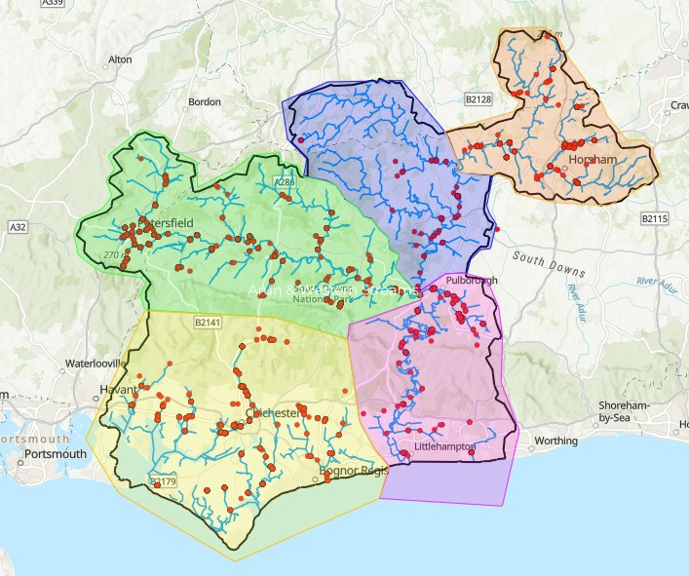

Slide 4
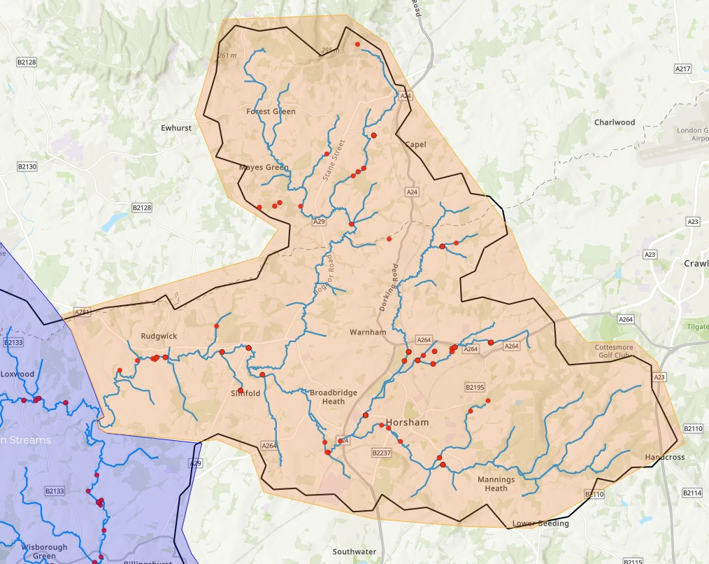

Slide 5
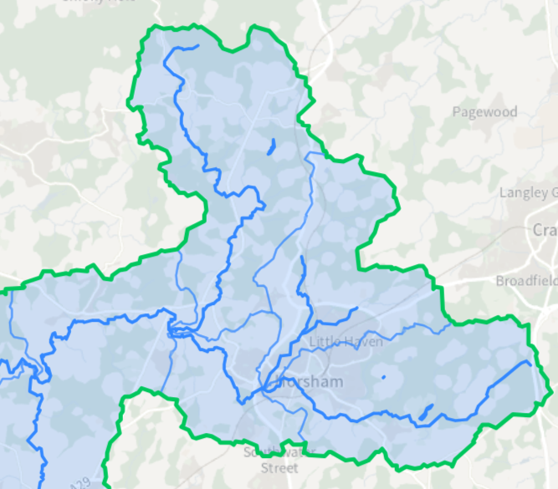
River Stats - Arun Upper Operational Catchment Data
North River
Boldings Brook
Arun Source
Arun Horsham
Arun U/S Pallingham
(this does go into the WSRT Lower Arun Group)

Slide 6
Water Body | Ecological Status | Length (km) | RNAG | No of sites monitored to determine status
North River | Moderate | 24.98 | Sewage Agriculture | 6
Boldings Brook | Poor | 11.06 | Sewage Road Run-Off Physical Modifications | 5
Arun Source | Poor | 15.75 | Sewage Agriculture Physical Modifications | 7
Arun Horsham | Poor | 7.27 | Sewage | 12
Arun U/S Pallingham | Moderate | 34.04 | Sewage Road Run-Off Agriculture | 17

Slide 7

Any Questions??

Slide 8
River Guardian Data Overview
Jan 1st to June 29th 2026
69 River Guardian surveys have been submitted
23 Different sites have been monitored
At least 7 of these sites have been monitored 4 times

Slide 9
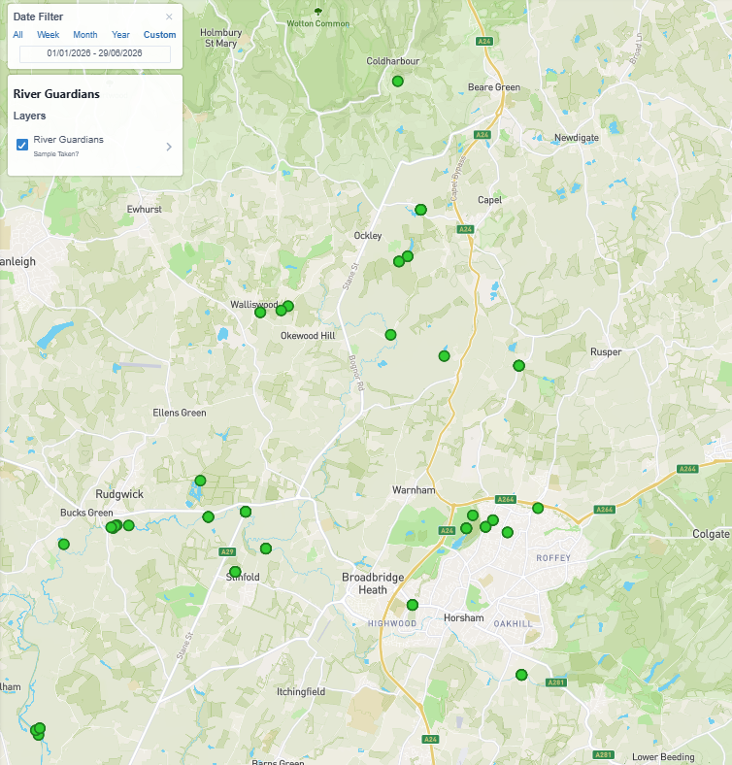
Sites: Jan 2026 until June 2026
Cartographer Website

Slide 10
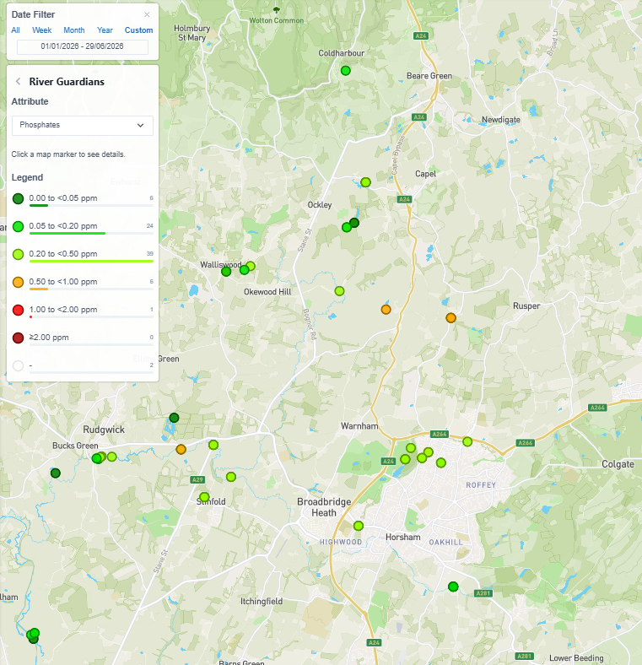
P

Slide 11
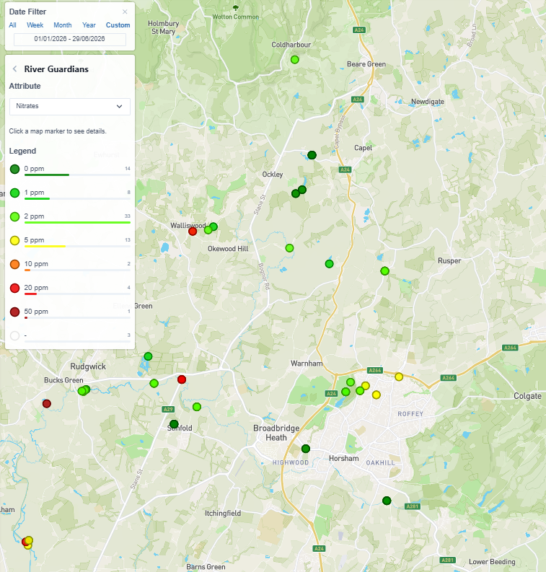
N

Slide 12

Result Ranges
Phosphate*1
Nitrate*2

Slide 13
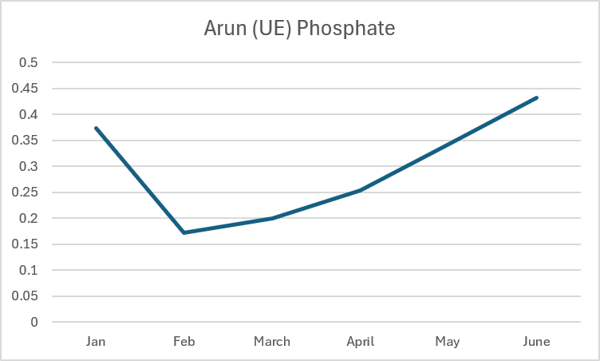
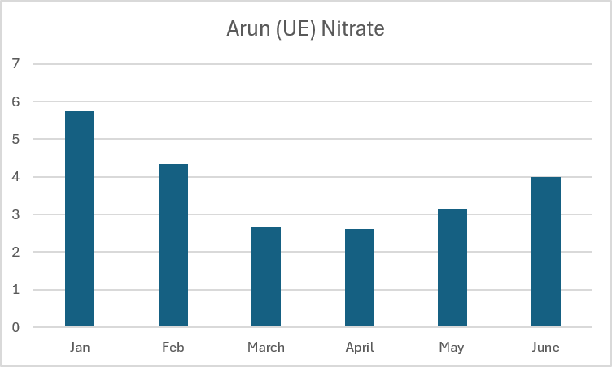
Arun (UE) – Result Averages
Jan to June 2026
0.6
Poor
Moderate

Slide 14


Result Ranges – Temperature and Turbidity
Temperatures
Turbidity

Slide 15
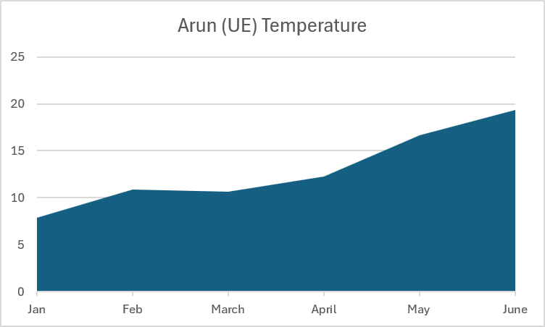
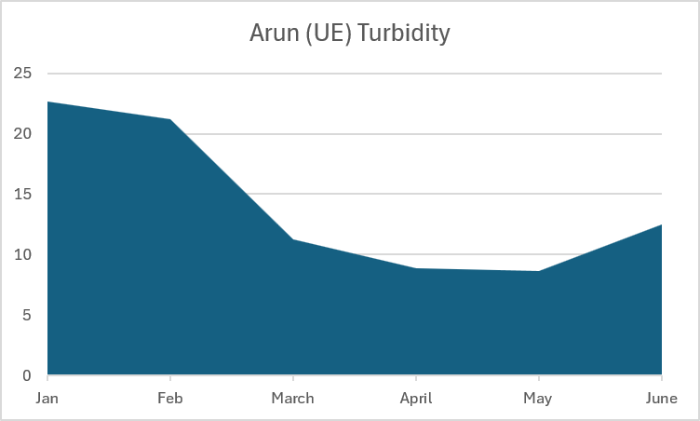
Arun (UE) – Result Averages
Jan to June 2026
Poor
Moderate

Slide 16
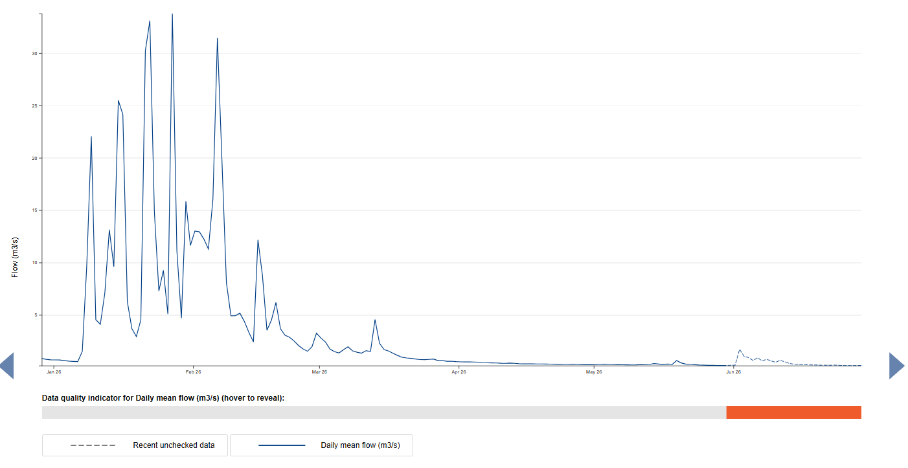
Flow Data - Alfoldean
Hydrology Data Explorer - DEFRA

Slide 17
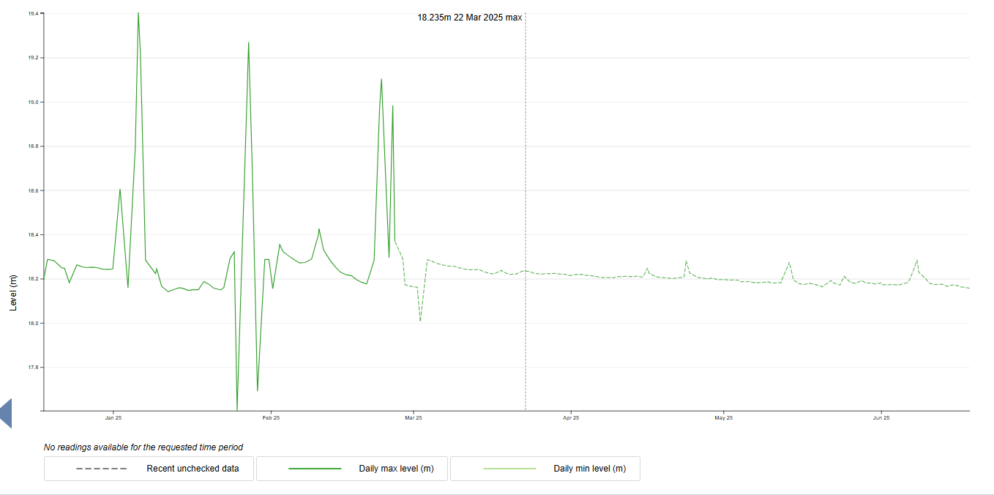
River Level Data – Wanford Gate

Slide 18
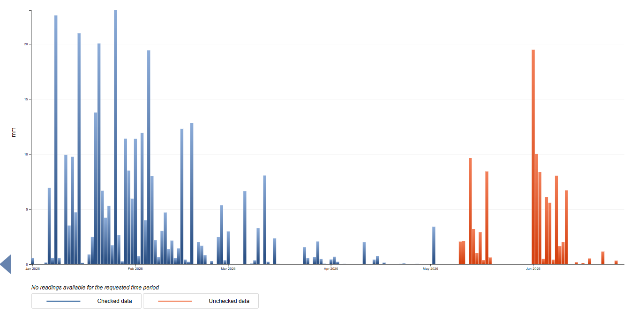
Rainfall Data – Itchingfield

Slide 19
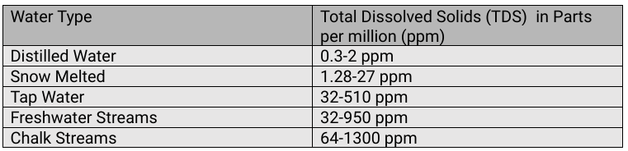
Result Ranges – TDS
Arun (UE) results ranged from 54 to 561
All normal, but please do check you measure TDS and not F

Slide 20
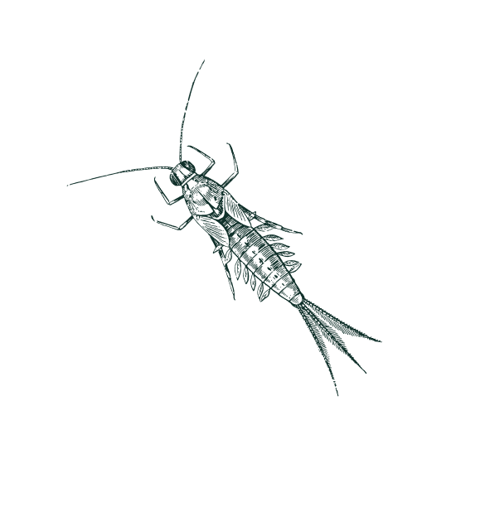
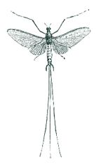
Riverfly review
Not currently being monitored
anywhere in this catchment group

Slide 21
Wildlife
Fish at 5 sites
Heron and Wagtail at 1 site
Dragonfly/Damselfly seen at 6 sites
Ducks at 5 sites
Goose at 1 site
Kingfisher at 1 site
Lots of birds and butterflies reported

Slide 22
Any Questions??

Slide 23
Overview – Sewage (Untreated)
10 spilling assets in the catchment group
(needs further investigation)
Discharged untreated sewage 735 times
for of over 2820 hours
Spill data can be found and downloaded from:
Rivers and seas watch
Check EDM data and download via:
Event Duration Monitoring - Storm Overflow Explorer

Slide 24
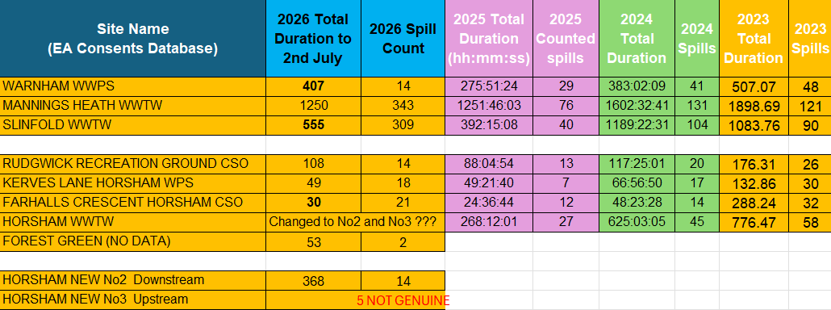

Slide 25
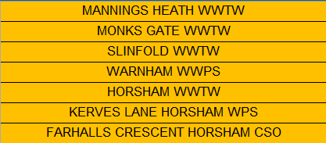
Sewage Discharges (untreated)
4 sites are currently not being monitored regularly
both up and downstream:

Slide 26

Other Issues
Soil run-off
Golf courses
Run off from fertilizers, slurry, agriculture
What are you finding?
?

Slide 27
Any Questions??

Slide 28


Slide 29
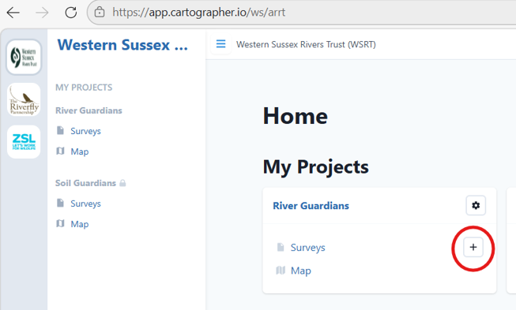

Slide 30
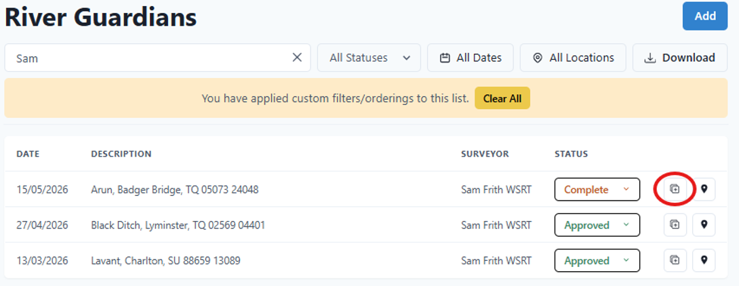
Duplicate

Slide 31
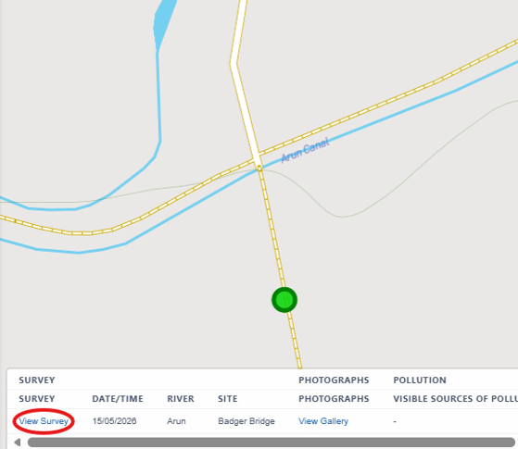
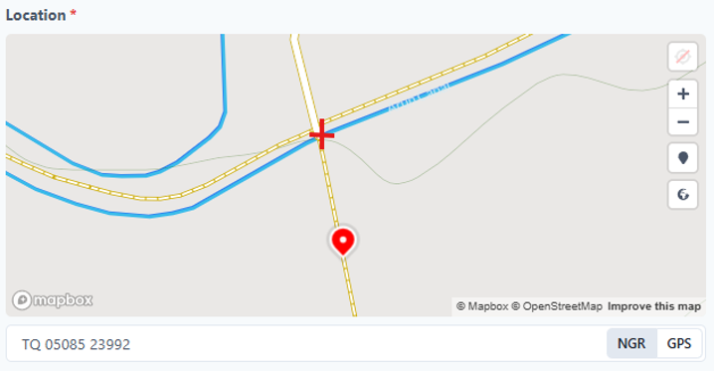
To move the pin
Open survey
Zoom in
Click on correct location

Slide 32
Any Questions??

Slide 33
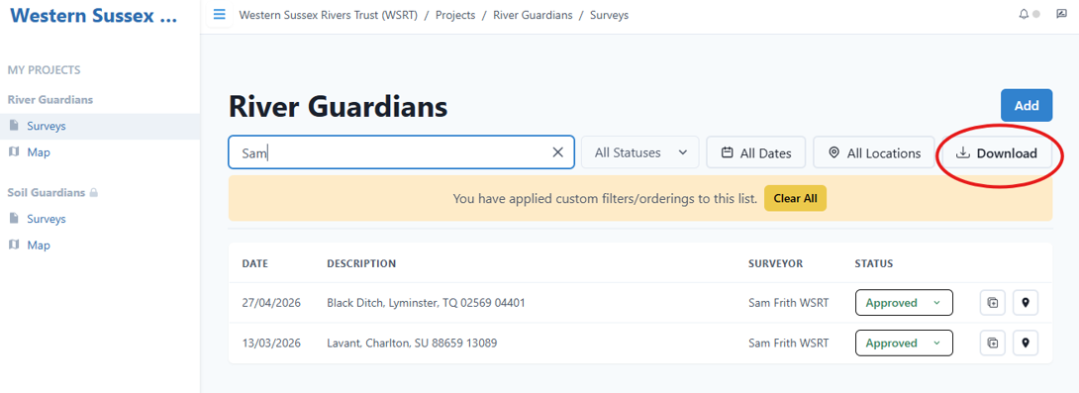
Download Survey Data – 3 ways
1
For specific survey data, use the search box then click download

Slide 34
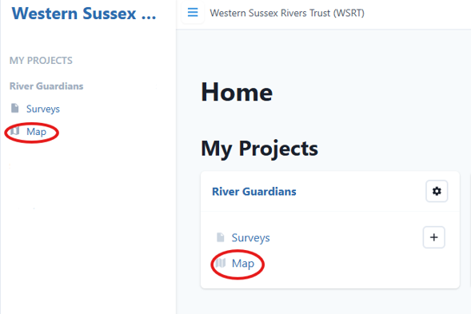
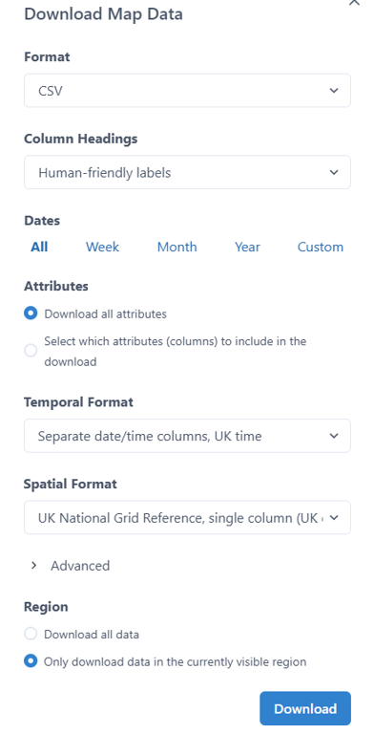
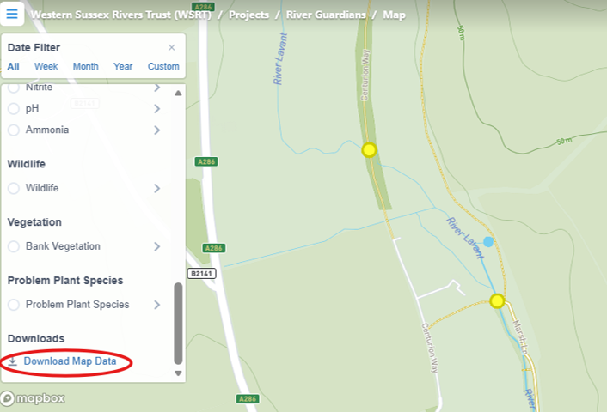
Open the map, zoom in so that the pins you are interested in are shown on the map page.
Scroll down to the bottom of the legend and click
‘Download Map Data’
2
For multiple sites located close together

Slide 35
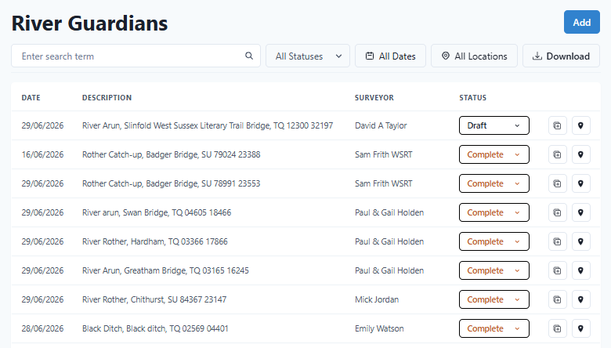
3
For larger areas

Slide 36
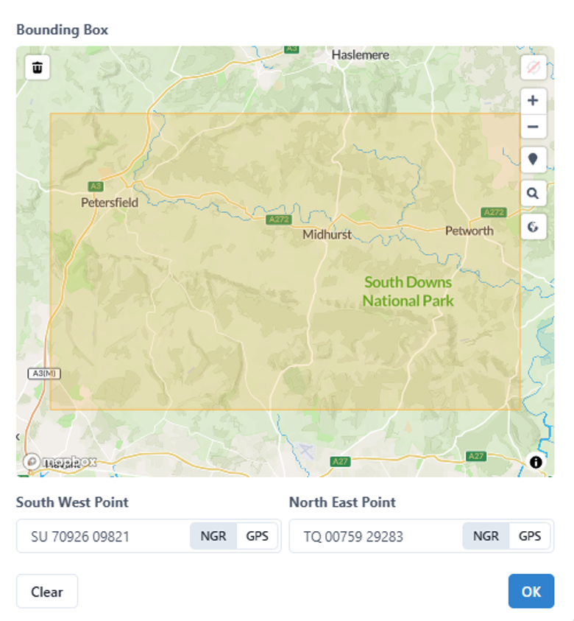
Select the area you are interested in by clicking on the map

Slide 37
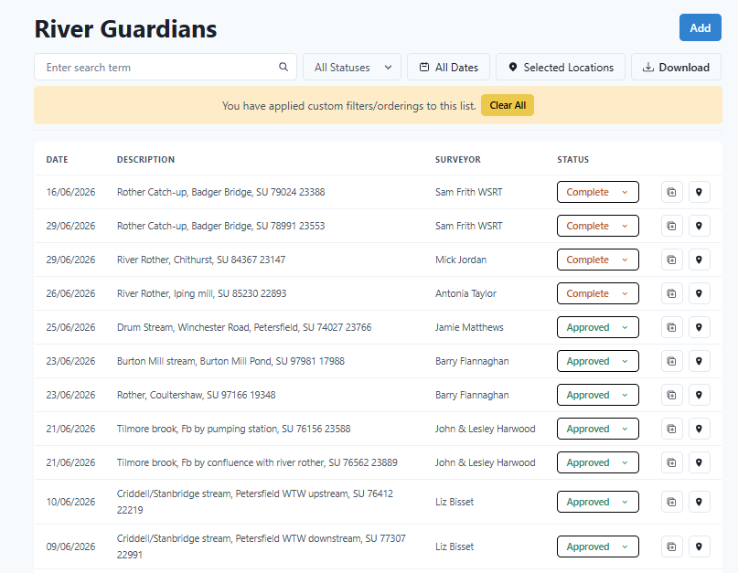

Slide 38

Any Questions??

Slide 39
Kit Maintenance
Cleaning and drying your kit at the end of your survey day is good practice.
Prolongs the life of your monitoring equipment
Prevents the spread of invasive species (INNS)
Prevents nutrient and chemical contamination between samples
Hanna Checker cuvettes, water collection device, syringe, Secchi tube
Rinse out with warm water and leave to air dry
TDS/Temp monitor pens
Soak the tips in lukewarm water for 5 mins then air dry before replacing cap

Slide 40

Health and Safety - Reminders
Always go out in pairs
Let someone know where you are heading and what time you expect to be back
Always wear gloves – Protect from water and reagents
River Guardian Risk Assessment is being updated
Link: Home and Dry - Water Safety Course - West Mercia Search and Rescue
Link: Tick awareness A5 leaflet for printing

