Slide 1
River Guardian
Rother Update
Water Quality Monitoring
Sam Frith

Slide 2
Thank You!
Without your volunteered time and energy, we would not have as good an idea of the health of the Rother as we do.
As a guardian, you know your river and can quickly report when something changes, red flagging an incident or a pollution source

Slide 3
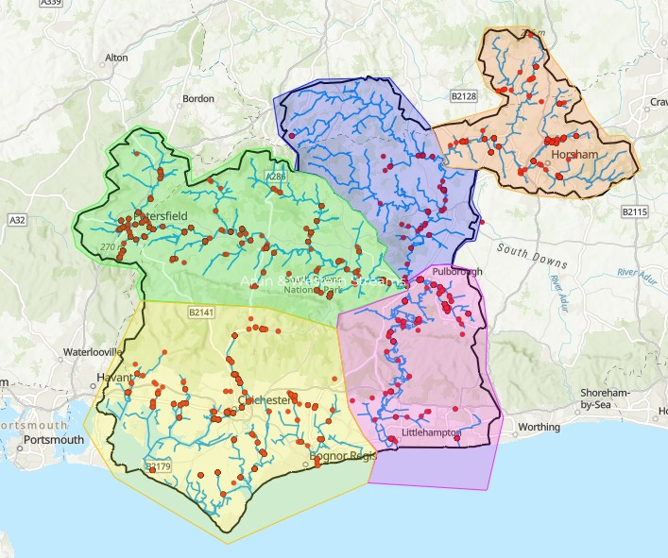

Slide 4
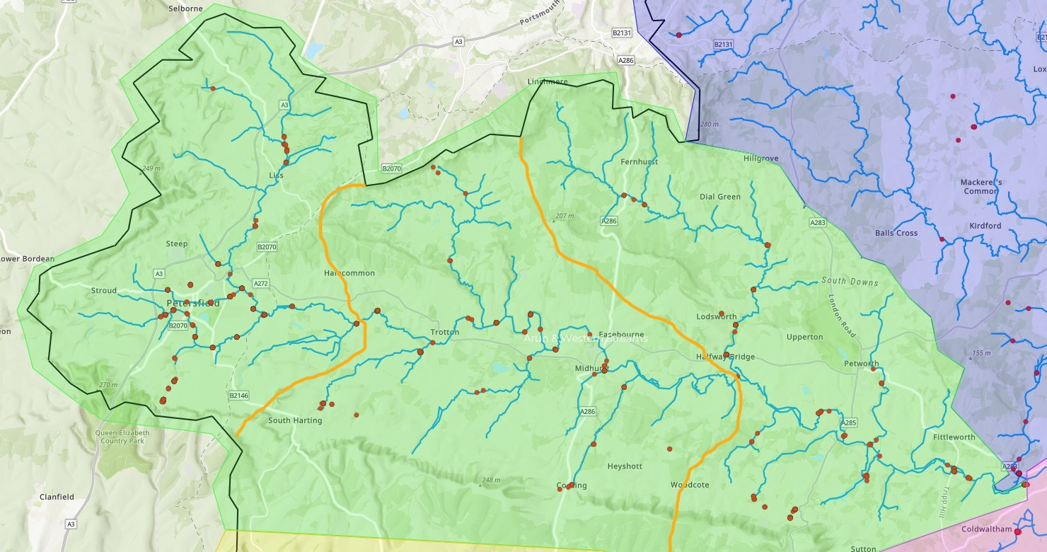

ROTHER
Upper
Lower
Mid

Slide 5
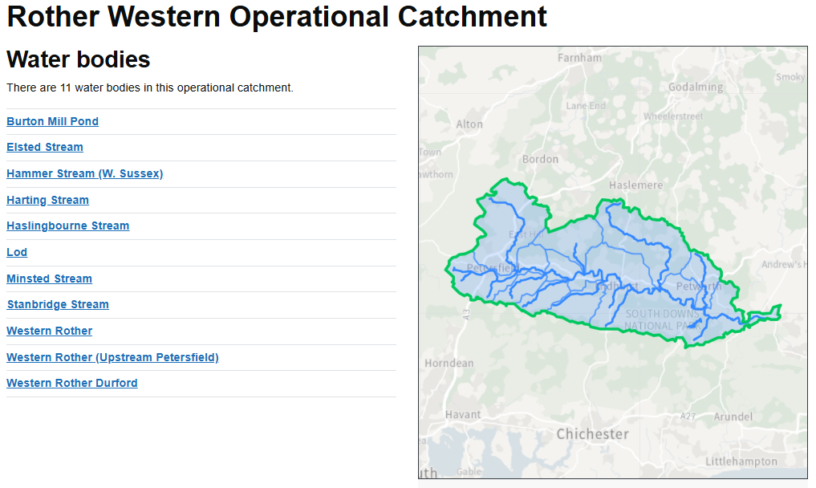
Rother Western Operational Catchment | Catchment Data Explorer

Slide 6
Data Overview
Jan 1st to June 17th 2026
151 River guardian surveys have been submitted
46 Different sites have been monitored
At least 24 of these have been monitored 4 times

Slide 7
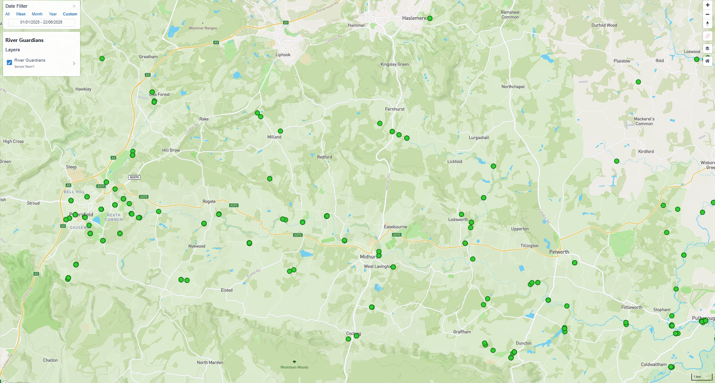
Sites: Jan 2025 until June 2026

Slide 8
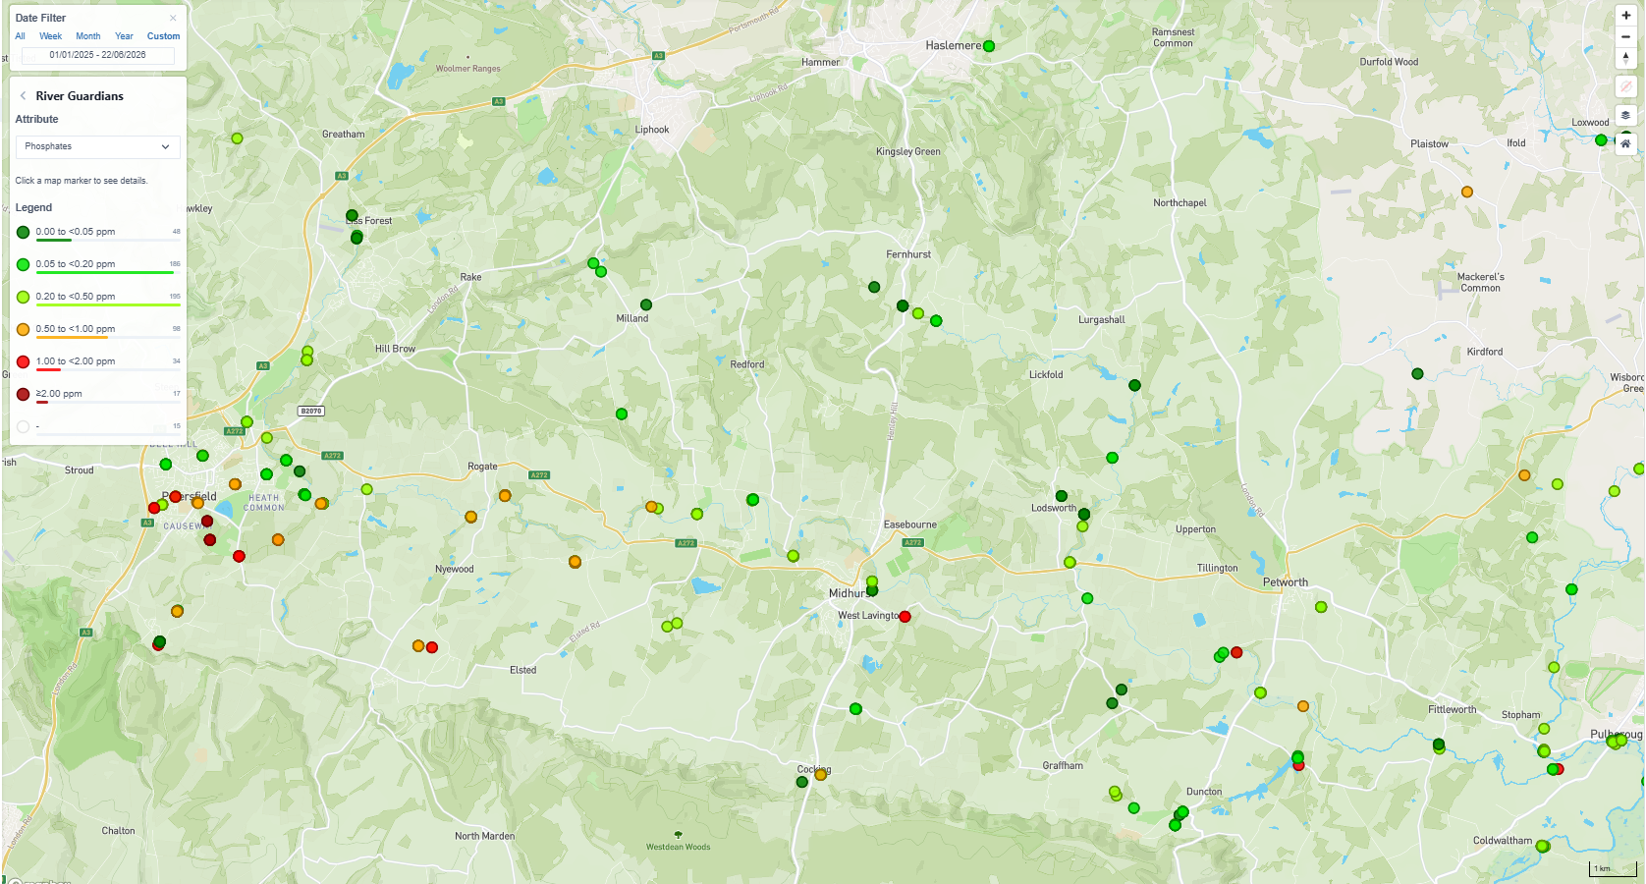
P

Slide 9
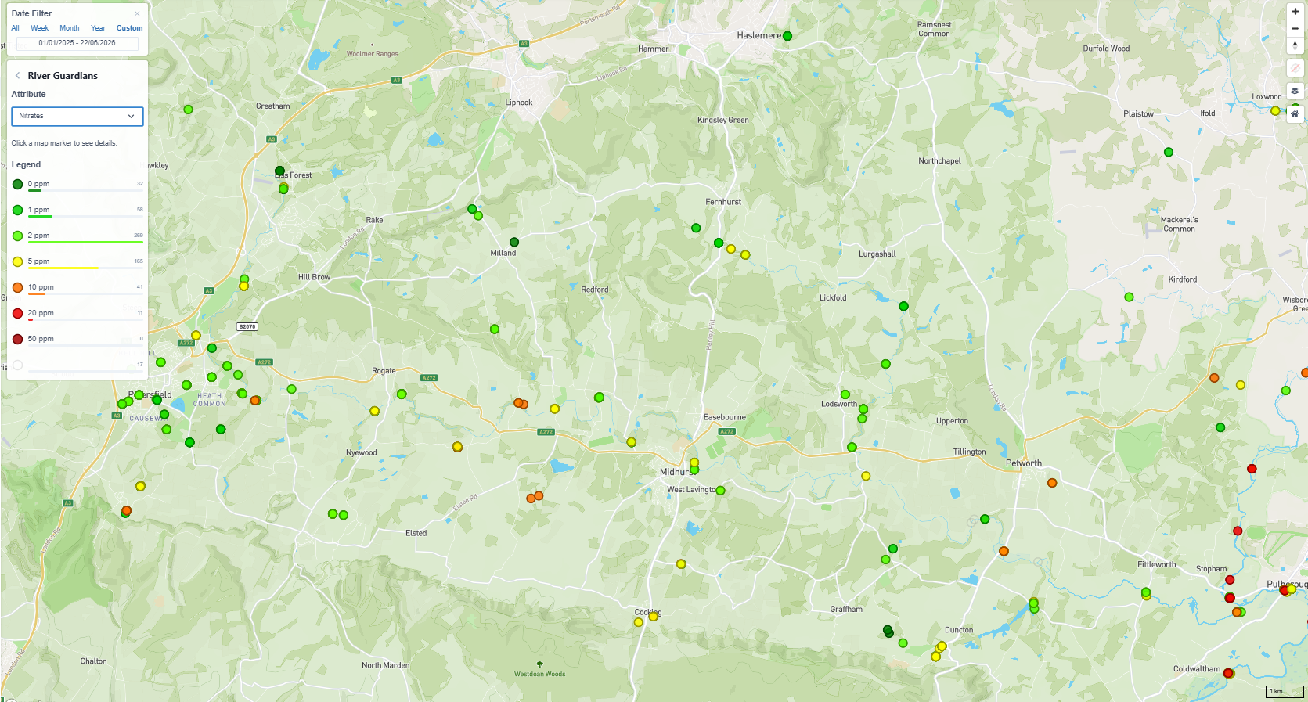
N

Slide 10
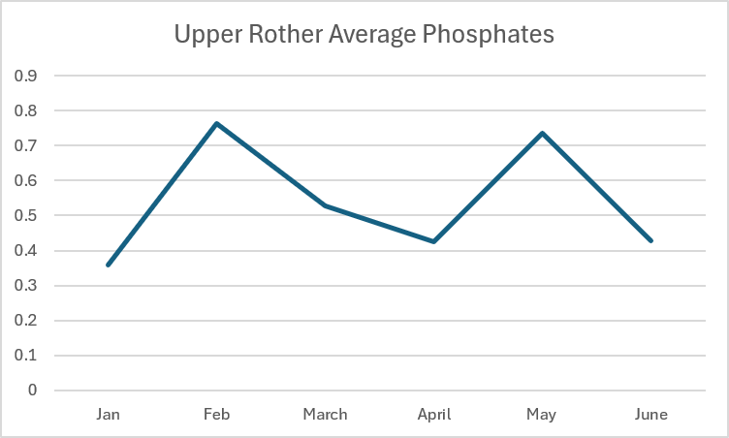
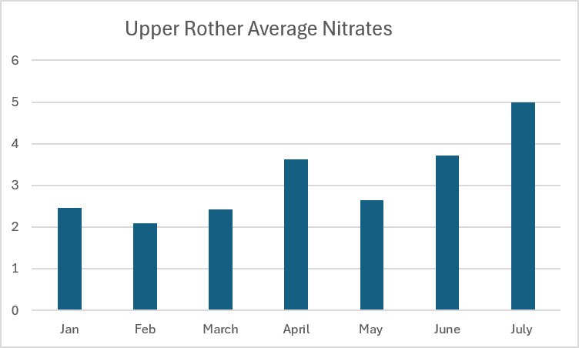
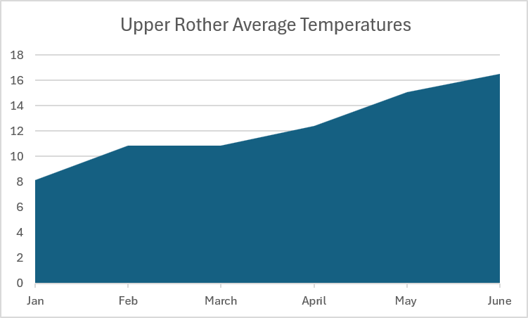
Upper Rother – Result Averages
Jan 2026 to June 2026
Poor
Moderate

Slide 11
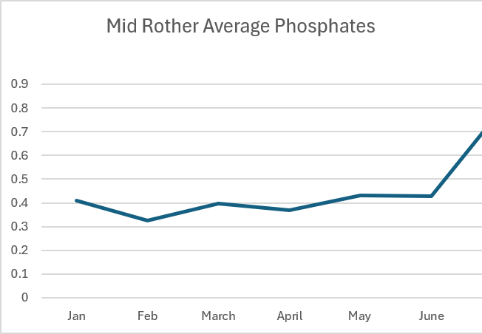
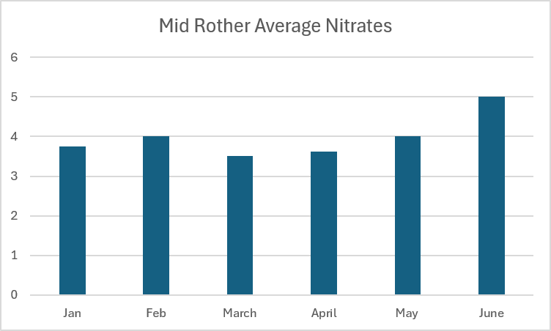
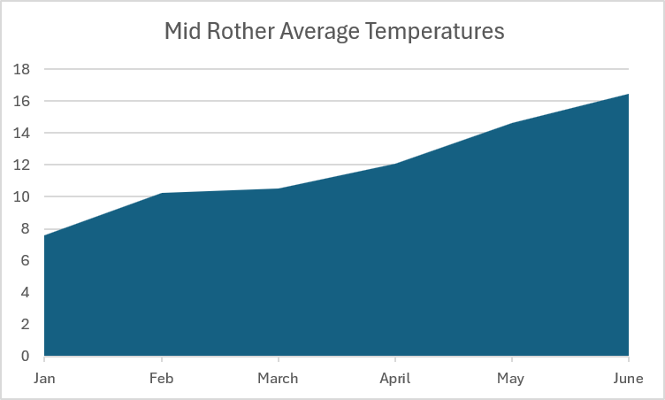
Mid Rother – Result Averages
Jan 2026 to June 2026
Poor
Moderate

Slide 12
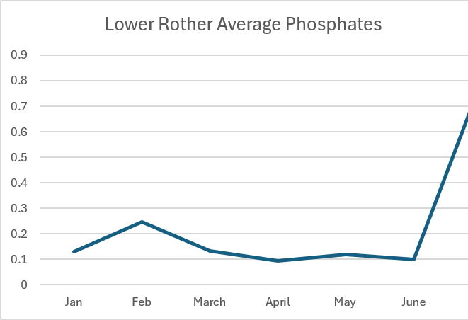
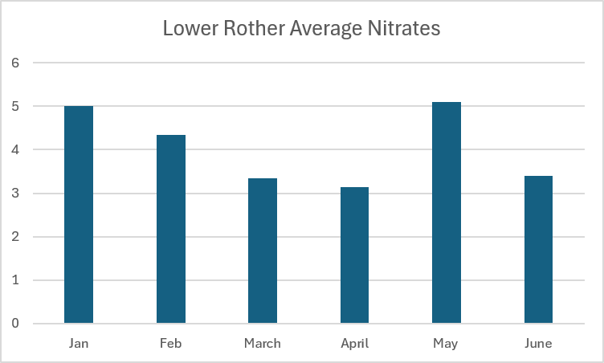
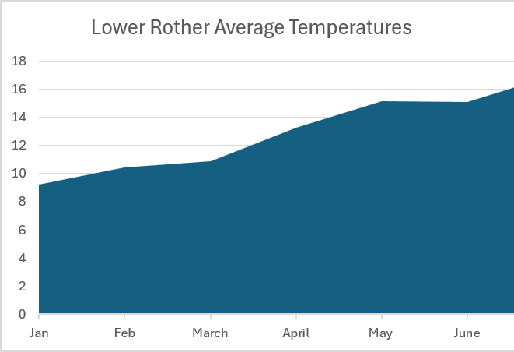
Lower Rother – Result Averages
Jan 2026 to June 2026
Poor
Moderate

Slide 13
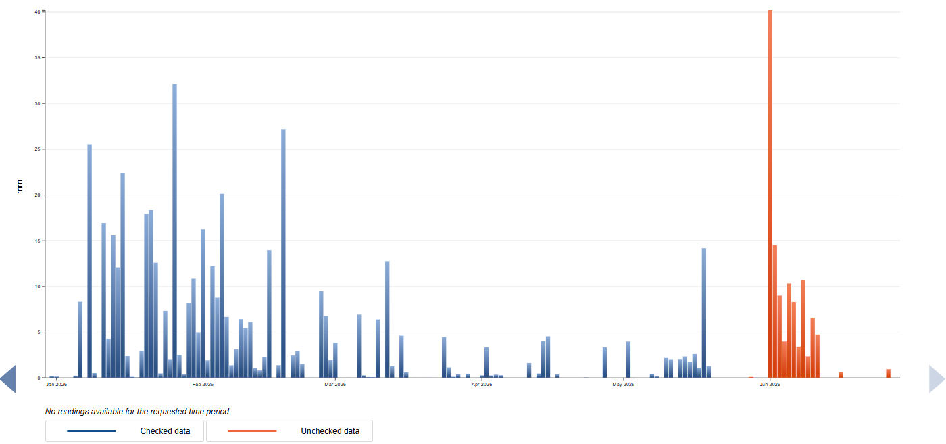
Rother Rainfall Data at Petersfield – last 6 months
Hydrology Data Explorer - Petersfield

Slide 14
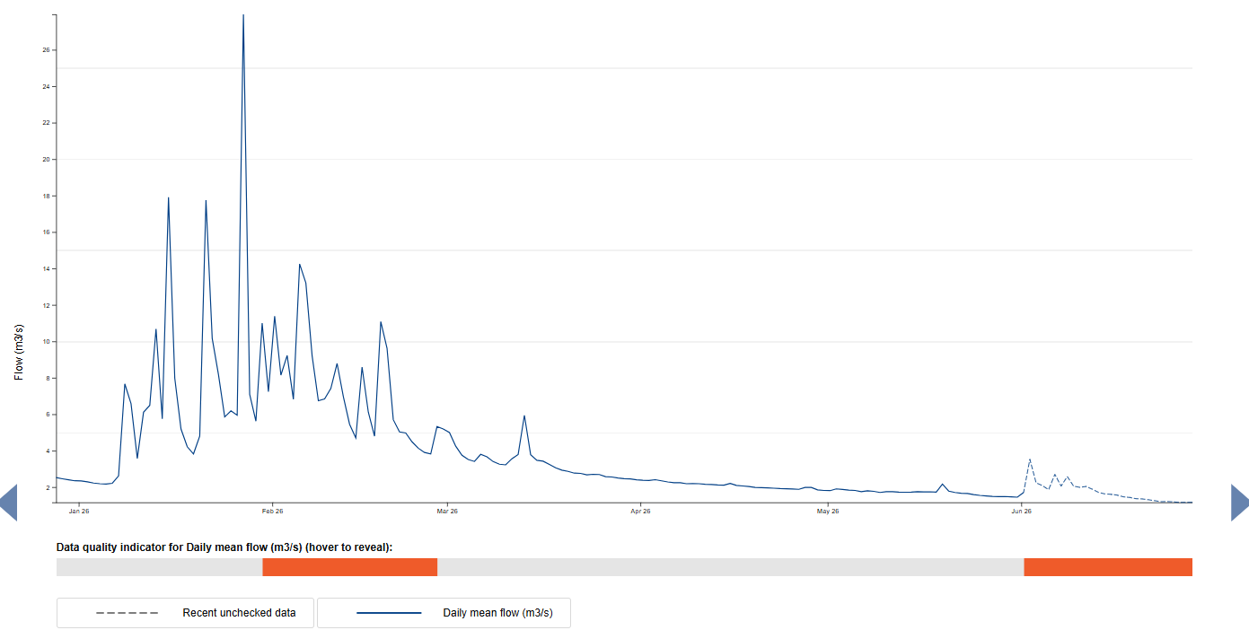
Rother Flow Data at Iping Mill – last 6 months
Hydrology Data Explorer - Iping Mill

Slide 15
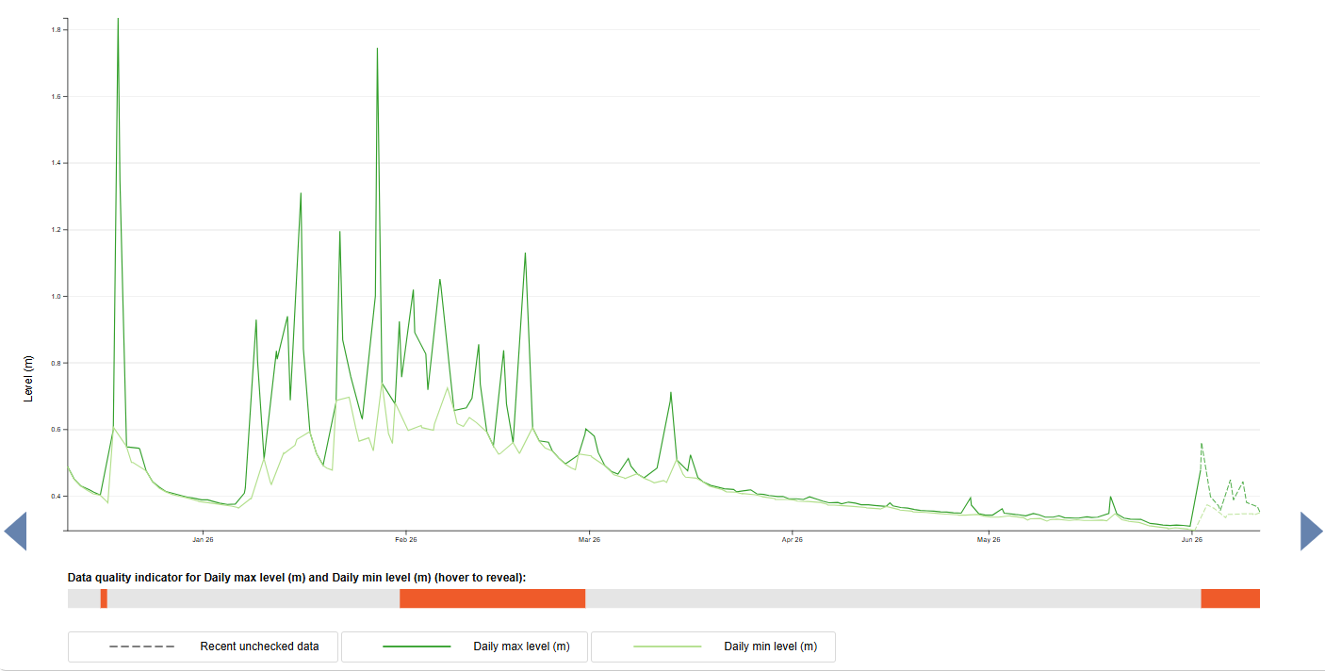
Rother Water Level Data at Iping Mill – last 6 months
Hydrology Data Explorer - Iping Mill

Slide 16

Result Ranges
Phosphate*1
Nitrate*2

Slide 17


Result Ranges – Temperature and Turbidity
Temperatures
Turbidity

Slide 18
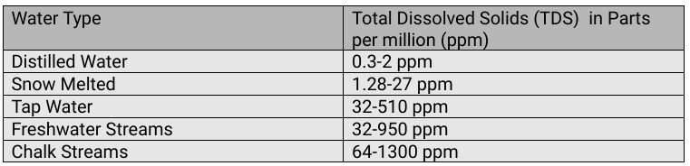
Result Ranges – TDS
Rother results ranged from 51 to 373
All normal, but please do check measuring TDS and not F

Slide 19

Any Questions??

Slide 20
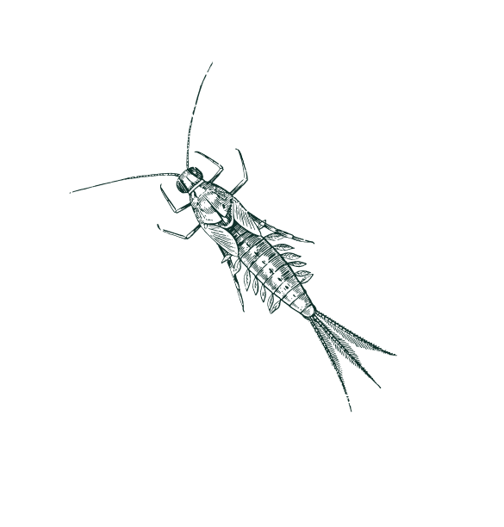
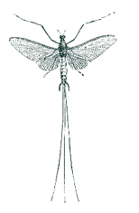
Rother Riverfly review
1st June 2025 to 26th June 2026
5 sites have been monitored by WSRT and SDNP groups
2 on the Upper Rother, 3 on the Lower Rother
No surveys breached their designated Trigger Level,
Hooray!!

Slide 21
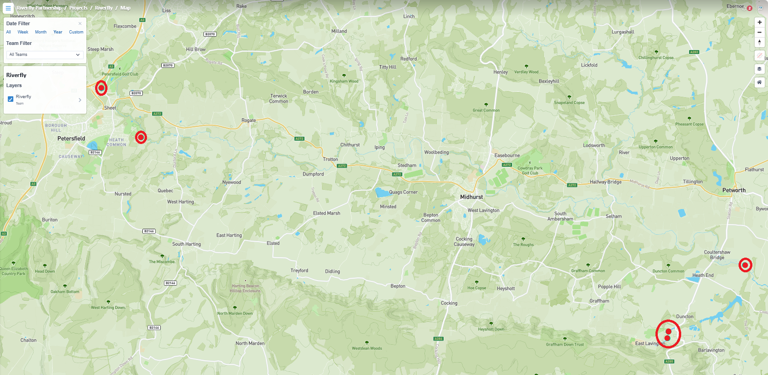
Rother Riverfly Locations
Adhurst Allotments (SDNP)
1 year of data
Footbridge behind Taro
(Keir), now inactive after 2 surveys
1 survey in Oct 2025
Botany Bay
Data since July 2025

Slide 22
Rother Riverfly Results
Species | Count
Cased Caddis | Up to 100
Caseless Caddis – | Up to 12
Mayfly (Ephemeridae) | Up to 100
Blue-Winged Olive (Ephemerellidae) | Up to 17
Flat-Bodied Stone Clinger (Heptageniidae) | Up to 120
Olives (Baetidae) | Up to 400
Stoneflies (Plecoptera) | None found in catchment
Freshwater Shrimp | Up to 600

Slide 23
Any Questions??

Slide 24


Slide 25
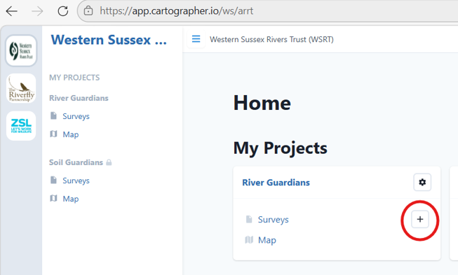

Slide 26
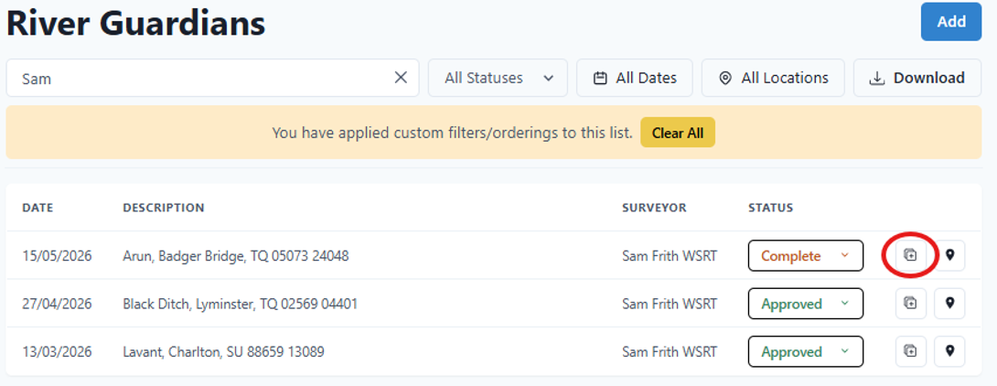
Duplicate

Slide 27
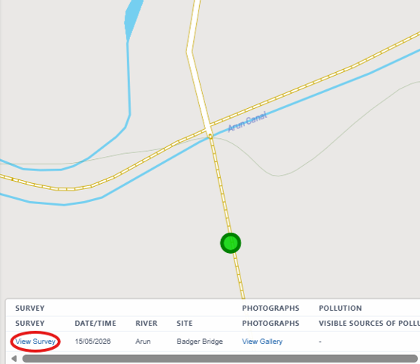
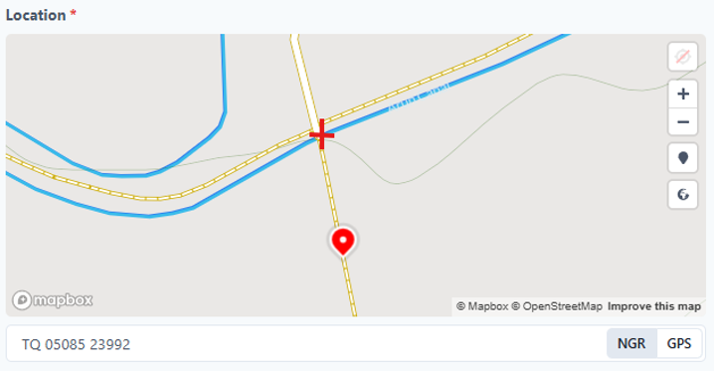
To move the pin
Open survey
Zoom in
Click on correct location

Slide 28
Any Questions??

Slide 29
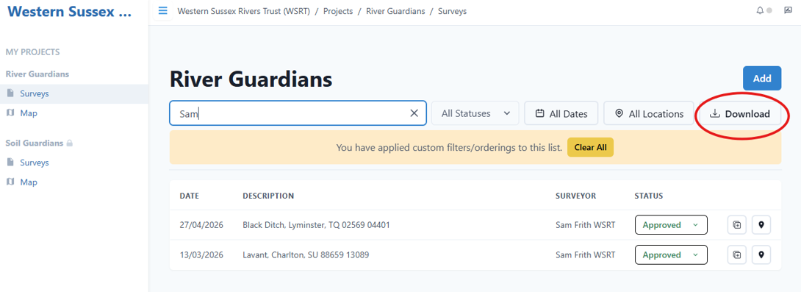
Download Survey Data – 3 ways
1
For specific survey data, use the search box then click download

Slide 30
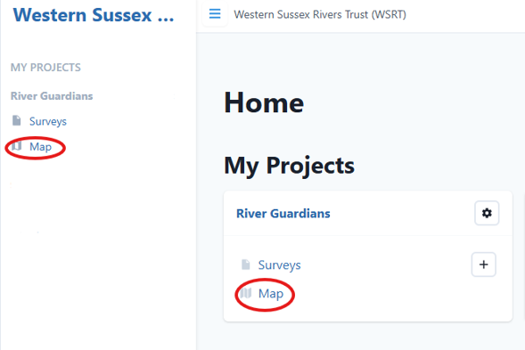
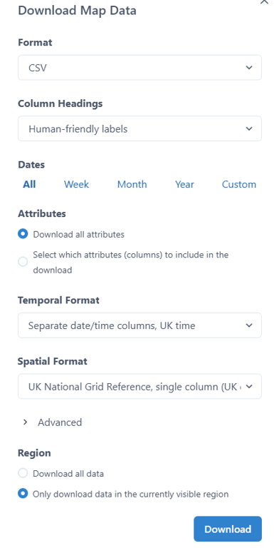
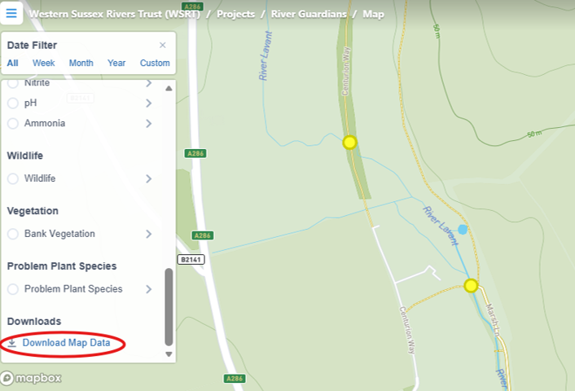
Open the map, zoom in so that the pins you are interested in are shown on the map page.
Scroll down to the bottom of the legend and click
‘Download Map Data’
2
For multiple sites located close together

Slide 31
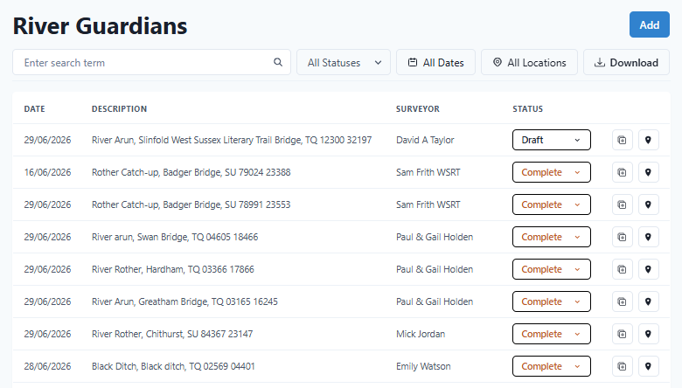
3
For larger areas

Slide 32
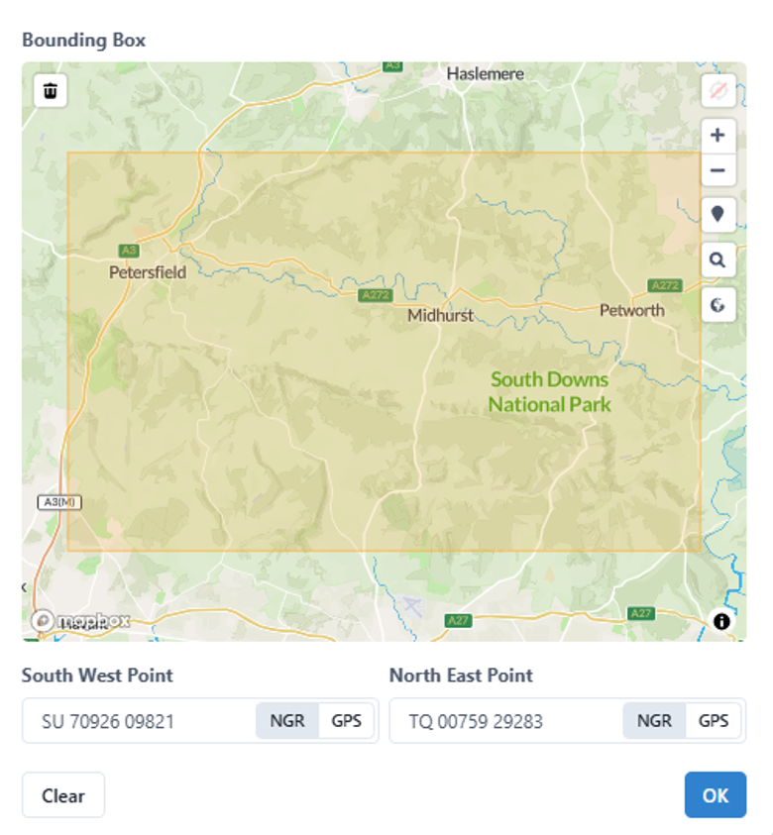
Select the area you are interested in by clicking on the map

Slide 33
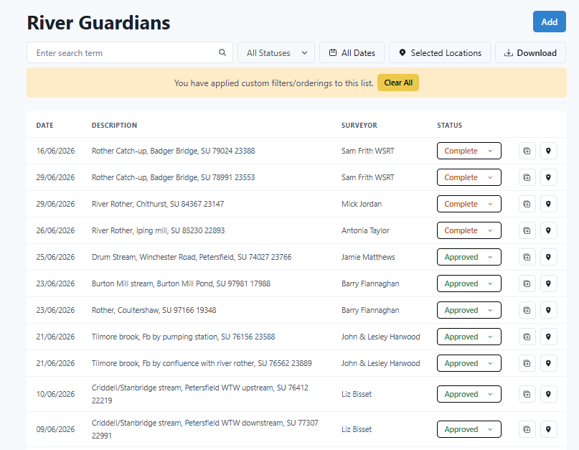

Slide 34
Any Questions??

Slide 35
Overview – Sewage Untreated
18 assets on the Rother
Discharged untreated sewage 4834 times
for of over 6872 hours
Spill data can be found and downloaded from:
www.riversandseaswatch.southernwater.co.uk/release-history
Check EDM data and download via:
Event Duration Monitoring - Storm Overflow Explorer

Slide 36
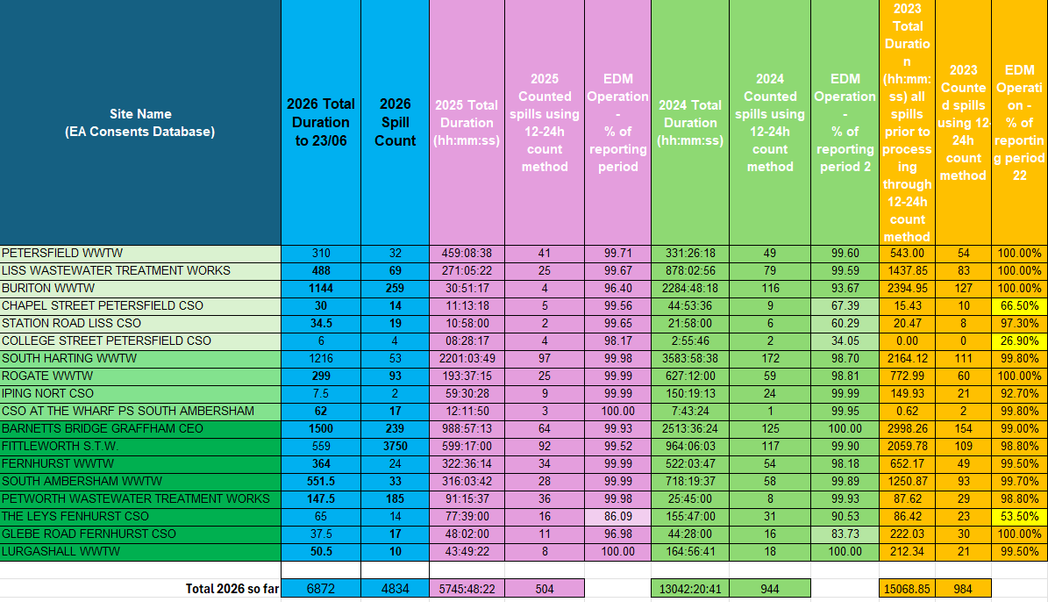

Slide 37
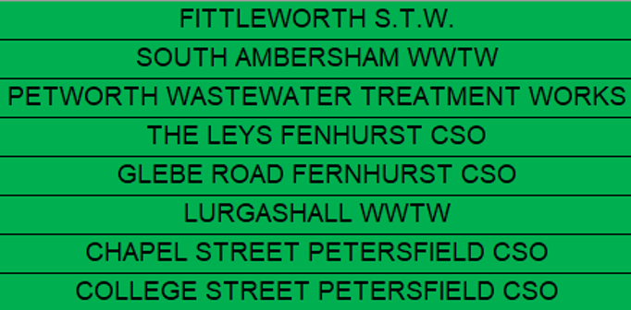
Sewage Discharges (untreated)
Chck
8 sites are currently not being monitored regularly both up and downstream:

Slide 38

Other Issues
Soil run-off, the Rother has big problems with sedimentation.
Golf courses, run off from fertilizers.
What else are you finding?

Slide 39
Kit Maintenance
Cleaning and drying your kit at the end of your survey day is good practice.
Prolongs the life of your monitoring equipment
Prevents the spread of invasive species (INNS)
Prevents nutrient and chemical contamination between samples
Hanna Checker cuvettes, water collection device, syringe, Secchi tube
Rinse out with warm water and leave to air dry
TDS/Temp monitor pens
Soak the tips in lukewarm water for 5 mins then air dry before replacing cap

Slide 40
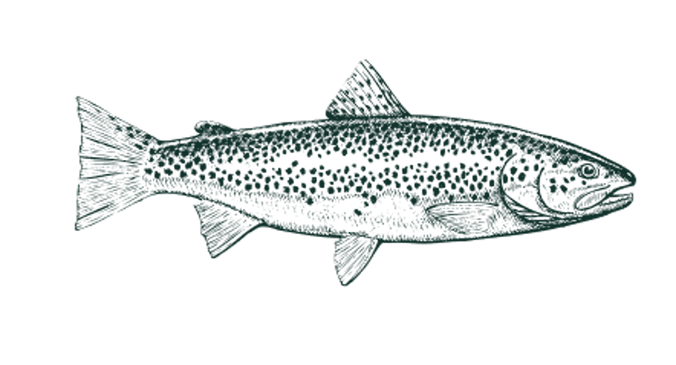
Health and Safety - reminders
Always go out in pairs
Let someone know where you are heading and what time you expect to be back
Always wear gloves – Protect from water and reagents
River Guardian Risk Assessment is being updated
Link: Home and Dry - Water Safety Course - West Mercia Search and Rescue
Link: Tick awareness A5 leaflet for printing

Slide 41
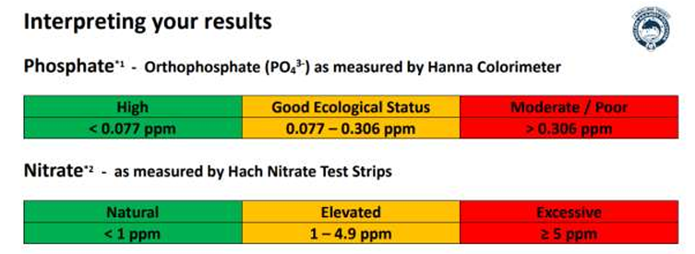
Results Ranges – Phosphate & Nitrate

