Slide 1
River Guardian
Western Streams Update
Water Quality Monitoring
Sam Frith

Slide 2
Thank You!
Without your volunteered time and energy, we would not have as good an idea of the health of the Western Streams as we do.
As a guardian, you know your river and can quickly report when something changes, red flagging an incident or a pollution source

Slide 3
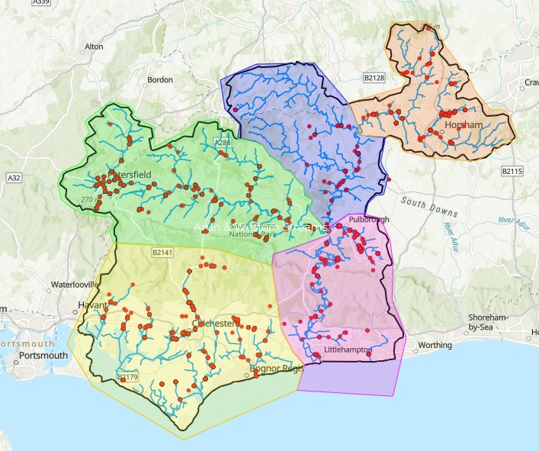

Slide 4
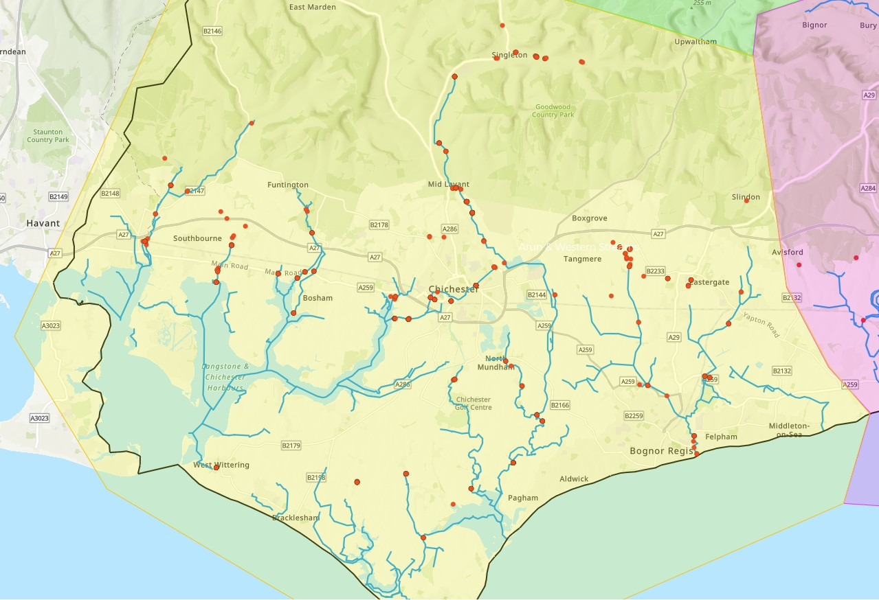

Slide 5
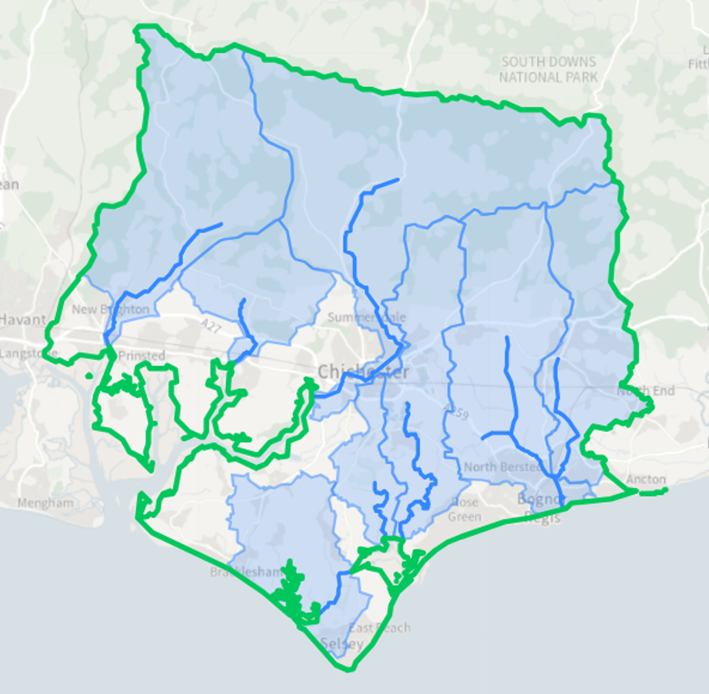

Western Stream Operational Catchment
Western Streams Operational Catchment Data Explorer

Slide 6
Data Overview
243 River guardian surveys have been submitted
60 Different sites have been monitored
At least 29 of these have been monitored 4 times
Jan 1st -
July 15th
2026

Slide 7
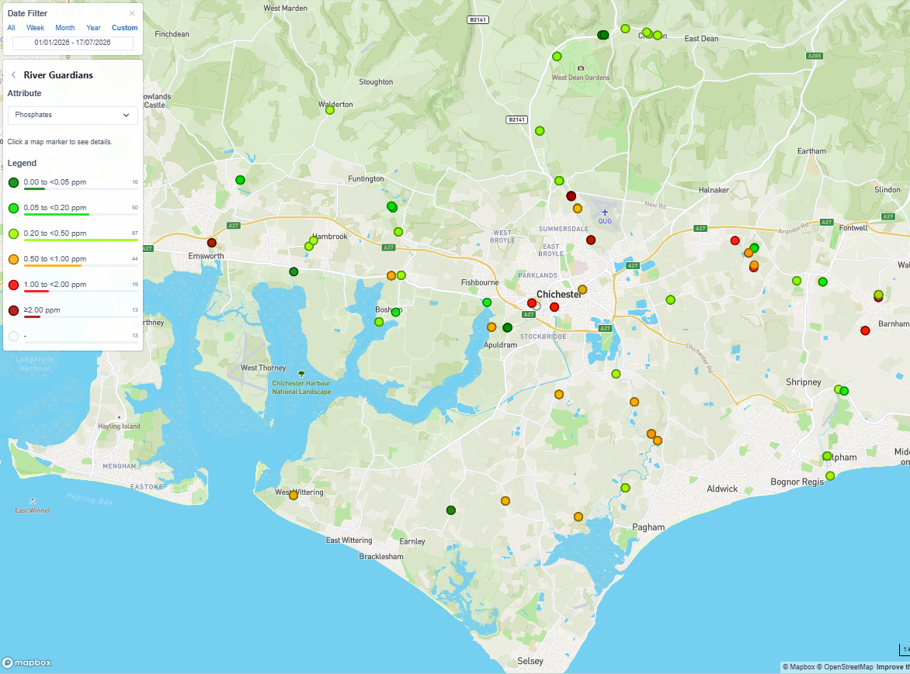
Phosphates
Sites:
Jan 2025 to
July 2026

Slide 8
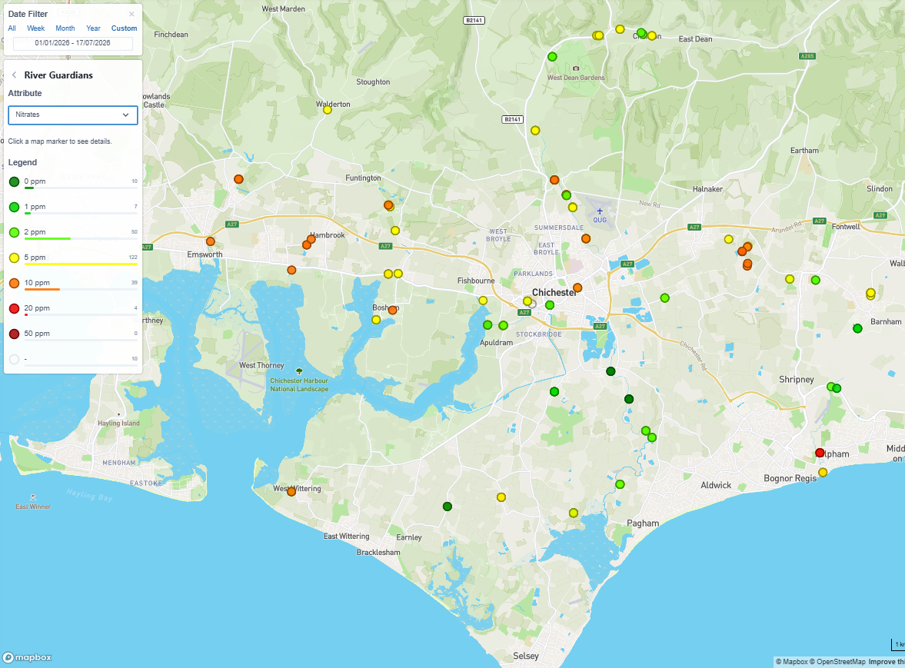
Nitrates
Sites:
Jan 2025 to
July 2026

Slide 9
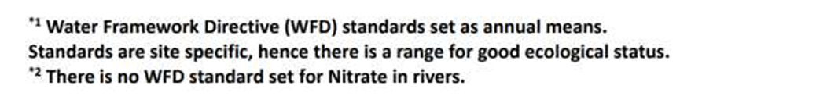
Result Ranges
Phosphate*1
Nitrate*2

Slide 10


Result Ranges – Temperature and Turbidity
Temperatures
Turbidity

Slide 11
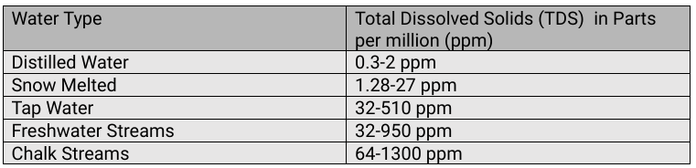
Result Ranges – TDS
Rother results ranged from 26 to 900
All normal, but please do check measuring TDS and not F

Slide 12

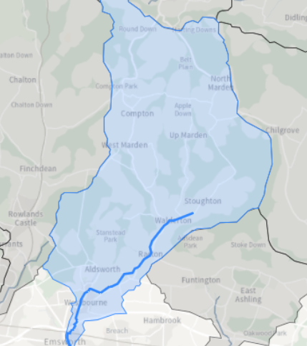
Ems
Ems | Catchment Data Explorer
Water Framework Directive (WFD)
Length: 8.8 km
Catchment Area: 60.1 km2
10 sites historically monitored to classify. 2 sites in 2022, Cycle 3
Brook Meadow - Invertebrates
Mill Pond – Ammonia, Dissolved Oxygen, Phosphate, Temp
Reason for Not Achieving Good (RNAG)
Flow, from Abstraction, impacts:
Invertebrates
Fish
Hydrological Regime
Physical Modifications, Flood protection, impacts:
Invertebrates
Fish
Other reasons:
Mercury and its Compounds
Polybrominated diphenyl ethers (PBDE)(flame‑retardant chemicals)

Slide 13
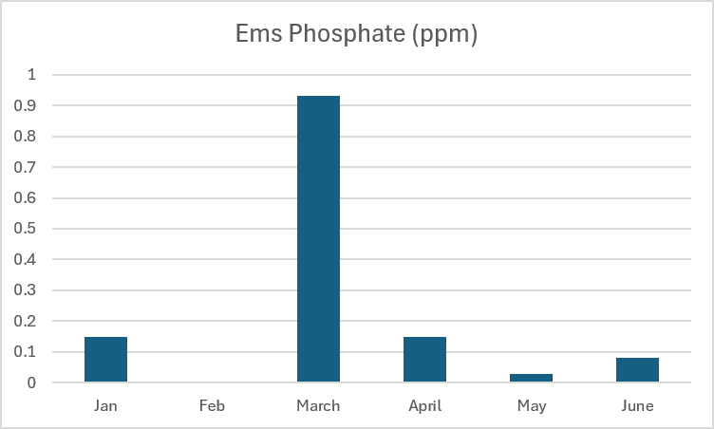
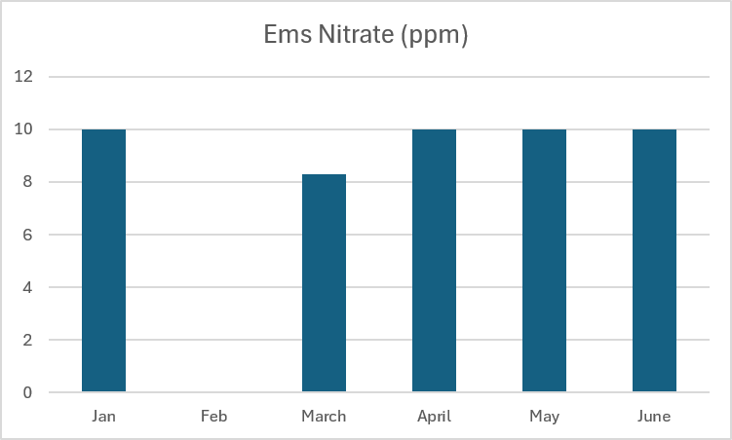
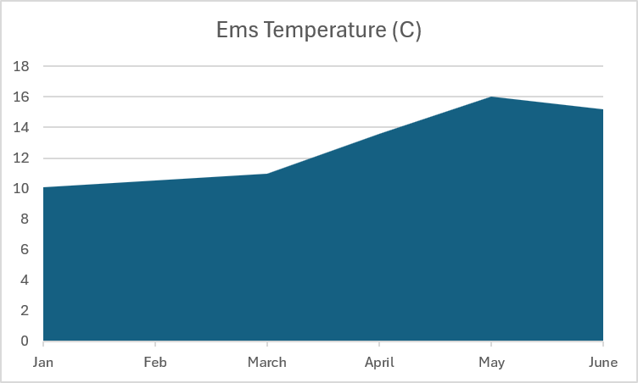
Ems – Result Averages
Jan 2026 to July 2026
Poor
Moderate

Slide 14
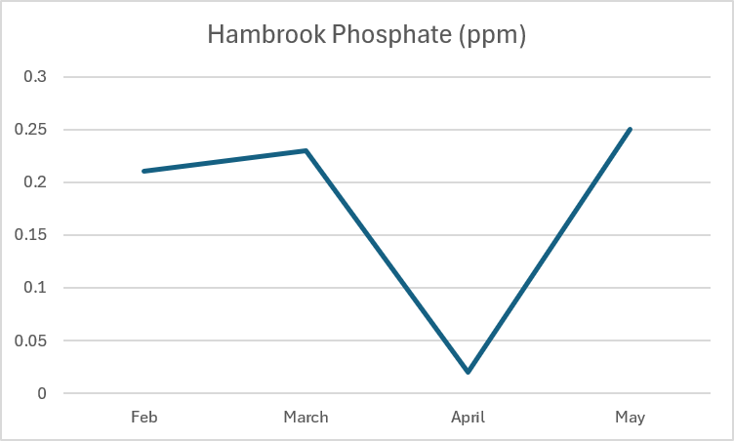
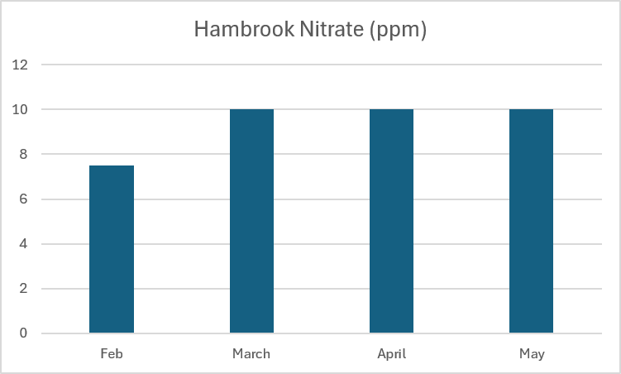
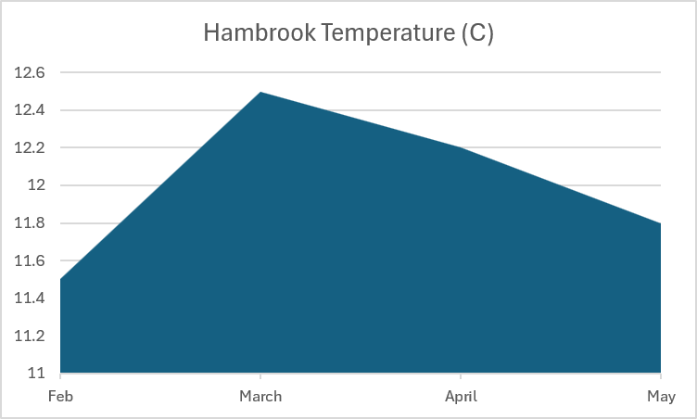
Hambrook – Result Averages
Jan 2026 to July 2026
No EA Data for WFD status
Poor
Moderate
Water Framework Directive

Slide 15
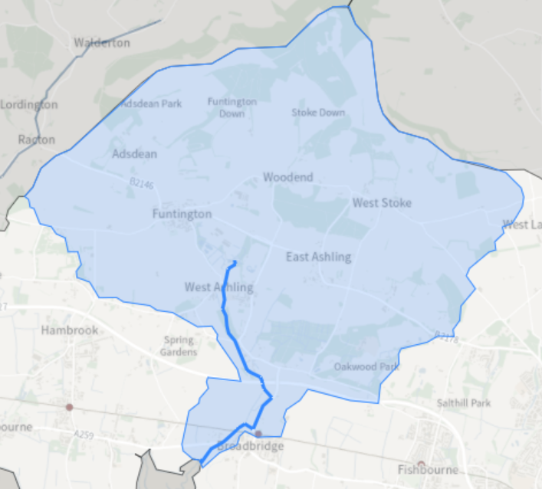
Bosham
Bosham Stream | Catchment Data Explorer
Length: 3.8 km
Catchment Area: 21.9 km2
5 sites historically monitored to classify.
1 site in 2022, Cycle 3
Colner Creek – Ammonia, Dissolved Oxygen, Phosphate, Temp
Reason for Not Achieving Good (RNAG)
Flow, from Abstraction, impacts:
Hydrological Regime
Physical Modifications, Urban & Transport, impacts:
Fish
Other reasons:
Mercury and its Compounds
Polybrominated diphenyl ethers (PBDE)(flame‑retardant chemicals)

Slide 16
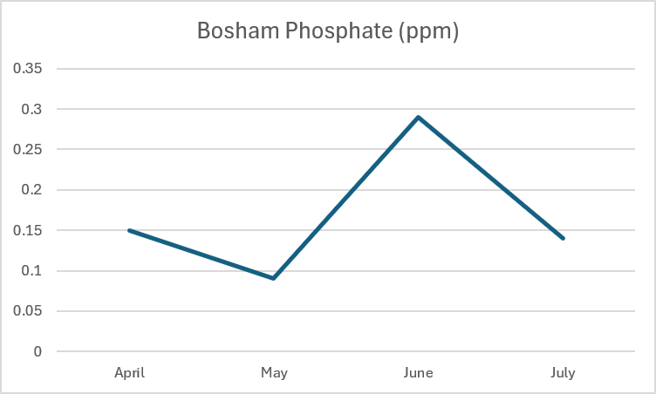
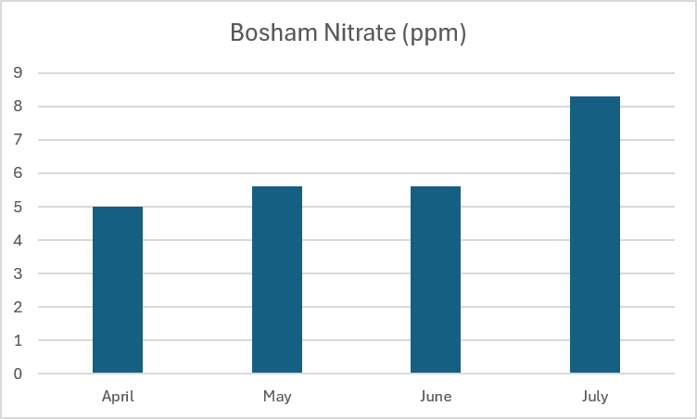
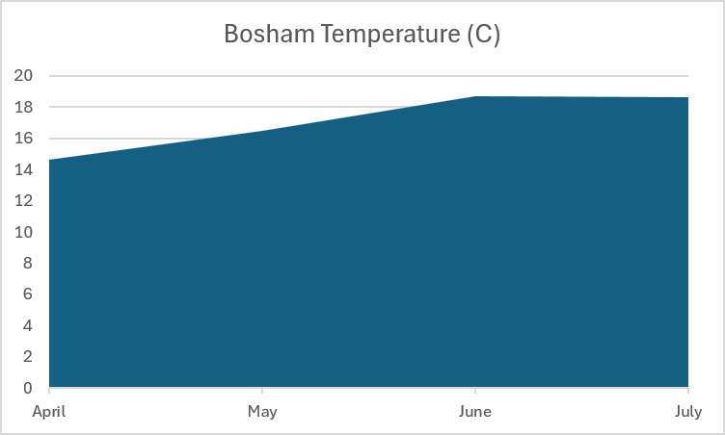
Bosham – Result Averages
Jan 2026 to July 2026
Poor
Moderate

Slide 17

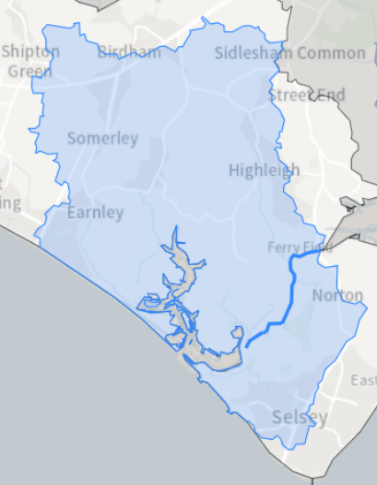
Broad Rife
Broad Rife | Catchment Data Explorer
Length: 2.9 km
Catchment Area: 27.9 km2
5 sites historically monitored to classify. 2 sites in 2022, Cycle 3
Ferry Pool Pond sluice and Sidlesham WWTW
Ammonia, Dissolved Oxygen, Phosphate, Temp
Reason for Not Achieving Good (RNAG):
Sewage (continuous)
Physical Modifications from Agriculture & Rural Land Management, Land Drainage & Poor soil management
Saline Intrusion
Impacts:
Invertebrates, Ammonia, Phosphate, Dissolved Oxygen
Reasons ‘Unknown’ - Under/Pending Investigation:
Benzo(ghi)perylene (occurs naturally in crude oil and coal tar)
Perfluorooctane sulphonate (PFOS)
Awaiting recovery from delivered measures
Mercury and its Compounds
Polybrominated diphenyl ethers (PBDE)(flame‑retardant chemicals)
Sidlesham WWTW currently unmonitored by RG (Keynor Rife in march 2025)

Slide 18
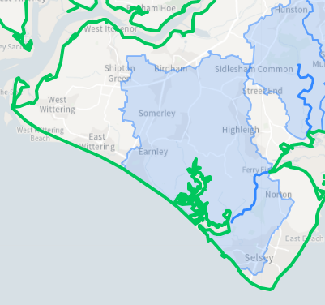
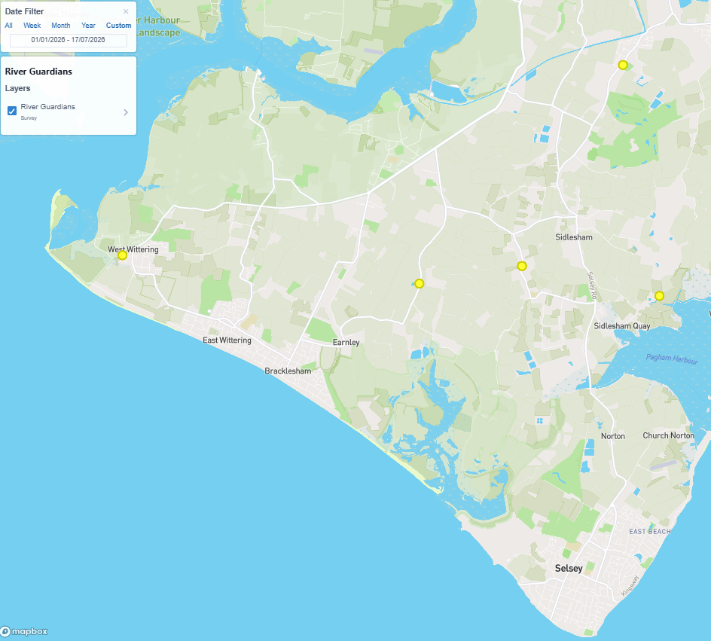
Broad Rife
Broad Rife | Catchment Data Explorer
West Wittering Rife
Highleigh Rife
Almodington Rife

Slide 19
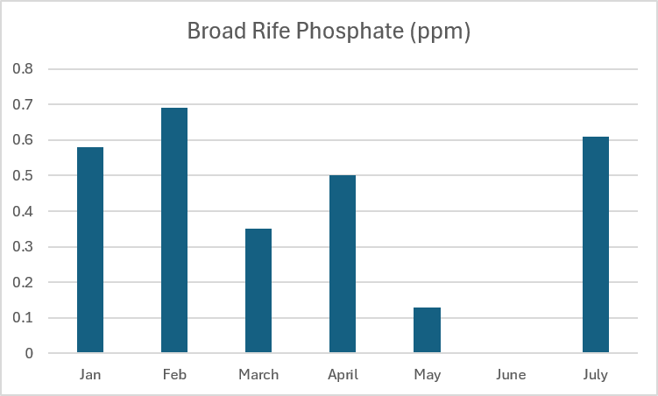
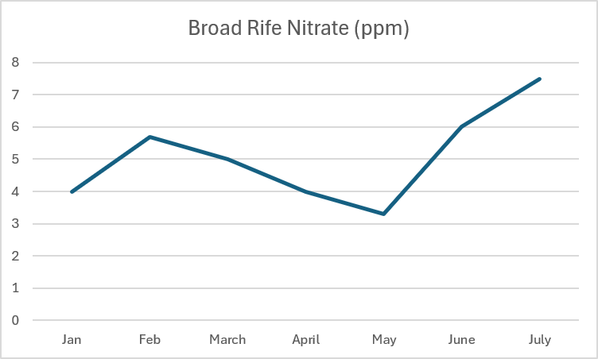
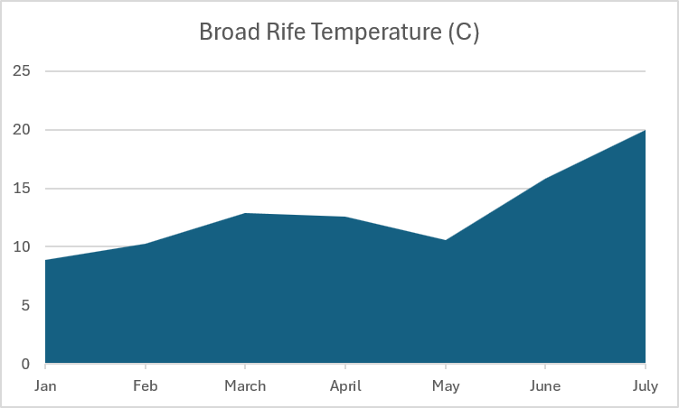
Broad Rife – Result Averages
Jan 2026 to July 2026
Poor
Moderate

Slide 20
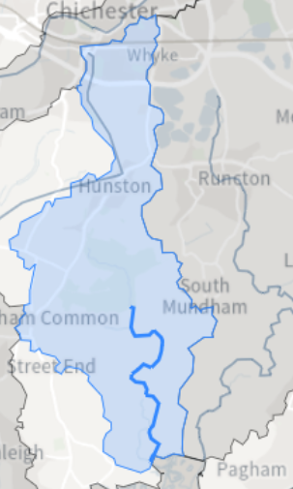
Bremere Rife
Length: 4 km
Catchment Area: 11.3 km2
3 sites historically monitored to classify.
0 sites monitored in 2022, Cycle 3:
Last was 2019 was:
South of Fisher – Macrophytes
Halsey Farm – Ammonia, DO, Phosphate, Temp
Reason for Not Achieving Good (RNAG):
Agriculture - Poor Soil & Nutrient Management
Drought - Flow
Impacts:
Invertebrate, Ammonia, Phosphate, Dissolved oxygen
Awaiting recovery from delivered measures:
Mercury and its Compounds
Polybrominated diphenyl ethers (PBDE)(flame‑retardant chemicals)
Bremere Rife | Catchment Data Explorer

Slide 21
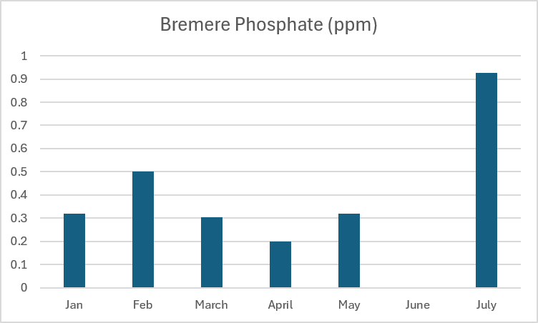
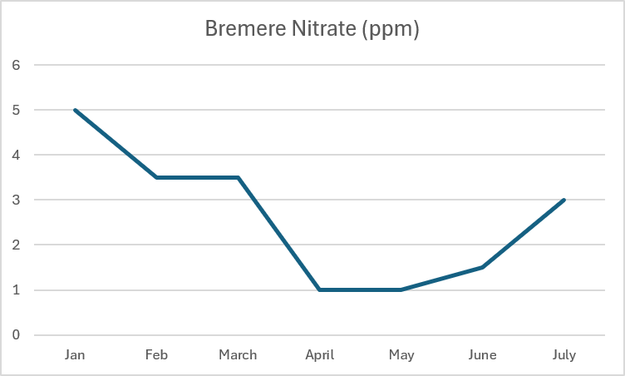
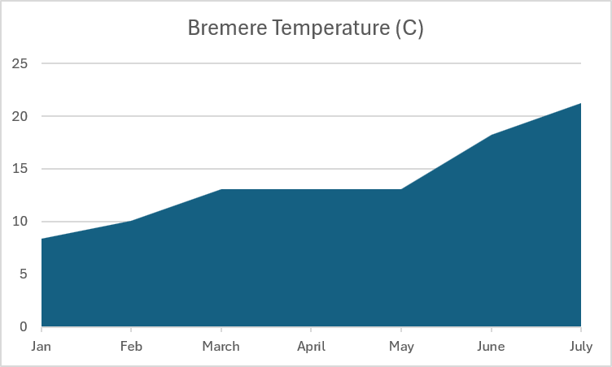
Bremer Rife – Result Averages
Jan 2026 to July 2026
Poor
Moderate

Slide 22
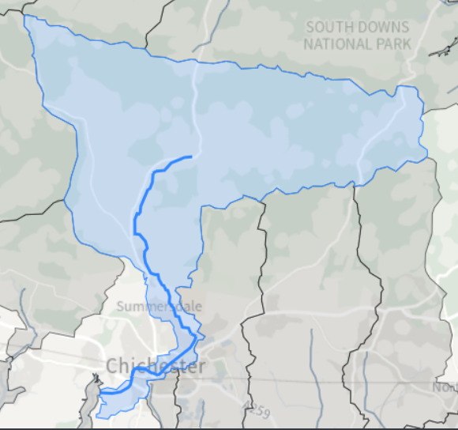
Lavant
Lavant (Sussex) | Catchment Data Explorer
Length: 15.4 km
Catchment Area: 91.1 km2
7 sites historically monitored to classify.
1 site in 2022, Cycle 3:
Apuldram – Ammonia, Dissolved Oxygen, Phosphate, Temp
Reason for Not Achieving Good (RNAG)
Sewage (continuous)
Impacts - Fish, Phosphate, Invertebrates
Other reasons:
Mercury and its Compounds
Polybrominated diphenyl ethers (PBDE)(flame‑retardant chemicals)
Macrophytes and Phytobenthos (plants and algae)

Slide 23
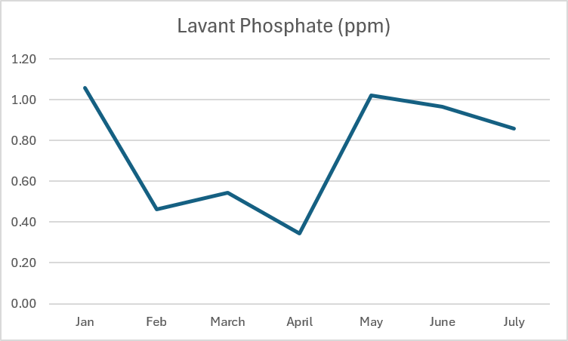
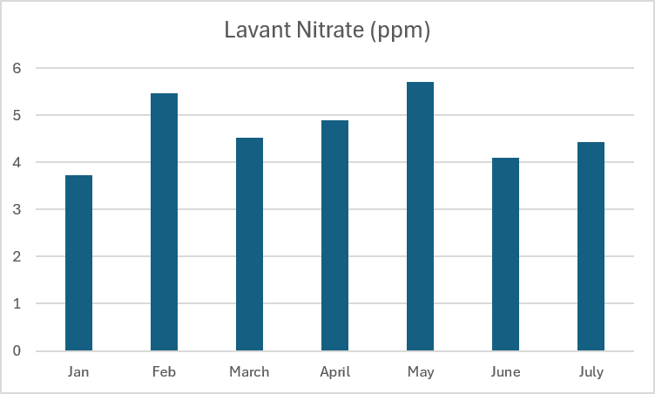
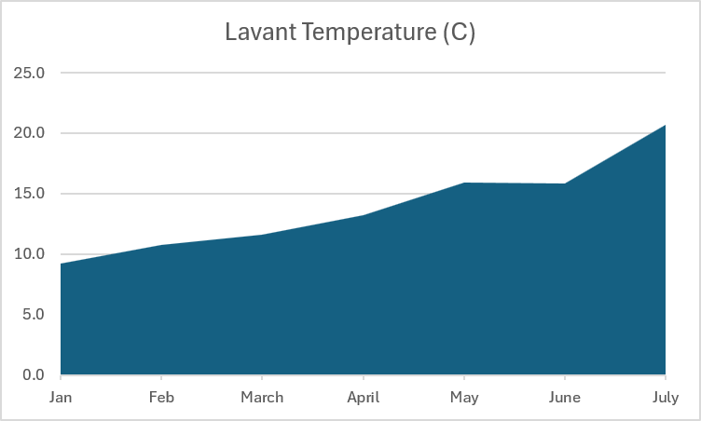
Lavant – Result Averages
Jan 2026 to July 2026
Dry Sites:
Tozer Way - January and July
Chichester College, west branch - due to ongoing construction work!
Poor
Moderate

Slide 24
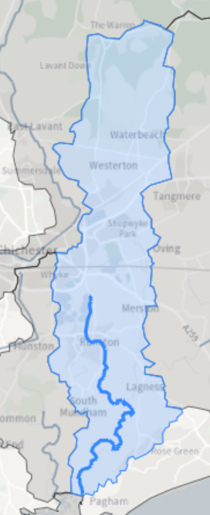
Pagham Rife
Length: 10.3 km
Catchment Area: 33.4 km2
8 sites historically monitored to classify.
1 site in 2022, Cycle 3:
By The Salt House – Ammonia, Temp, Dissolved Oxygen (Bad), Phosphate, Acid Neutralising Capacity
Reason for Not Achieving Good (RNAG):
Sewage (continuous)
Physical Modifications - Flood Protection, Reservoir, Land Drainage
Agricultural – Poor Soil Management, Poor Nutrient Management
Invasive (floating Pennywort)
Impacts:
Flow, Temp, Fish, Invertebrates, Ammonia, Phosphate, Dissolved Oxygen, Macrophytes and Phytobenthos (plants and algae),
Reasons ‘Unknown’ - Under/Pending Investigation:
Perfluorooctane sulphonate (PFOS)
Awaiting recovery from delivered measures
Mercury and its Compounds
Polybrominated diphenyl ethers (PBDE)(flame‑retardant chemicals)
Pagham Rife | Catchment Data Explorer

Slide 25
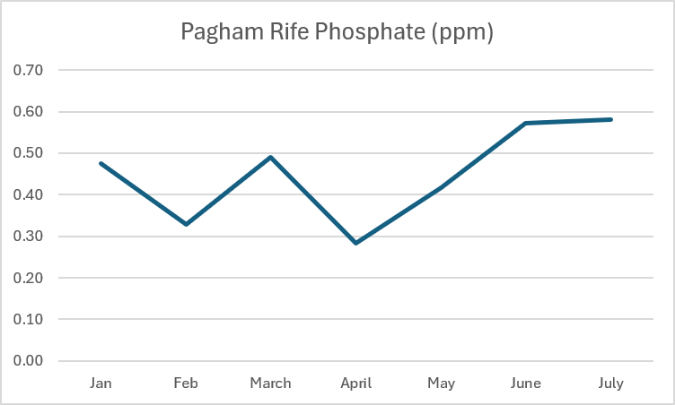
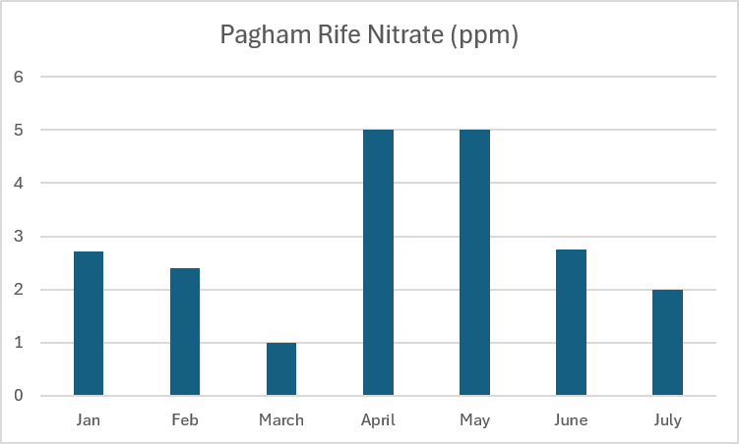
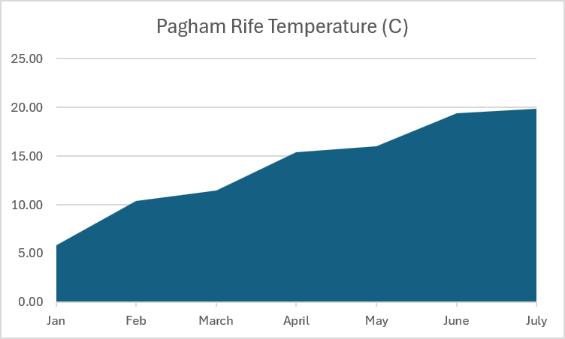
Pagham Rife – Result Averages
Jan 2026 to July 2026
Data including:
RLFAS = River Lavant Flood Alleviation Scheme
Also known as Chichester Flood Relief Channel
Poor
Moderate

Slide 26
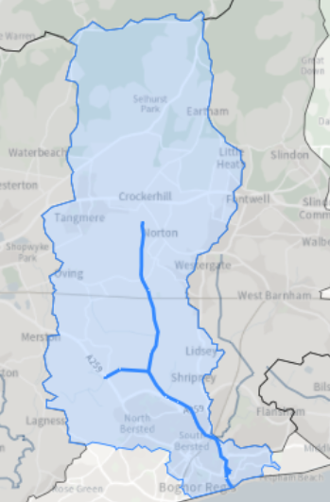

Aldingbourne Rife
Length: 10.3 km
Catchment Area: 51.2 km2
7 sites historically monitored to classify.
3 sites in 2022, Cycle 3:
Bognor - Upstream Bultins, Tesco, U/S Gladius Way
All monitored - Ammonia, Dissolved Oxygen (DO), Phosphate, Temp
Reason for Not Achieving Good (RNAG):
Misconnections, Road Run-off, Sewage (continuous), Poor Soil Management, Poor Nutrient Management, Land Drainage, Flood Protection
Impacts:
Invertebrates, Phosphate, DO, Fish,
Awaiting recovery from delivered measures
Mercury and its Compounds
Polybrominated diphenyl ethers (PBDE)(flame‑retardant chemicals)
Aldingbourne Rife | Catchment Data Explorer

Slide 27
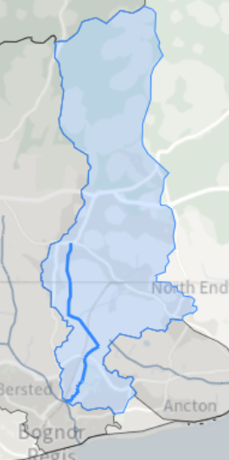
Lidsey Rife
Length: 6.35 km
Catchment Area: 35.6 km2
6 sites historically monitored to classify.
1 site in 2022, Cycle 3:
Bognor – Behind Sainsbury before joining Aldingbourne
Monitored - Ammonia, Dissolved Oxygen (Bad), Phosphate, Temp
Reason for Not Achieving Good (RNAG):
Misconnections, Sewage (continuous), Drought, Poor Soil Management, Horticulture
Impacts:
Invertebrates, Phosphate, Dissolved Oxygen
Awaiting recovery from delivered measures
Mercury and its Compounds
Polybrominated diphenyl ethers (PBDE)(flame‑retardant chemicals)
Lidsey Rife | Catchment Data Explorer

Slide 28
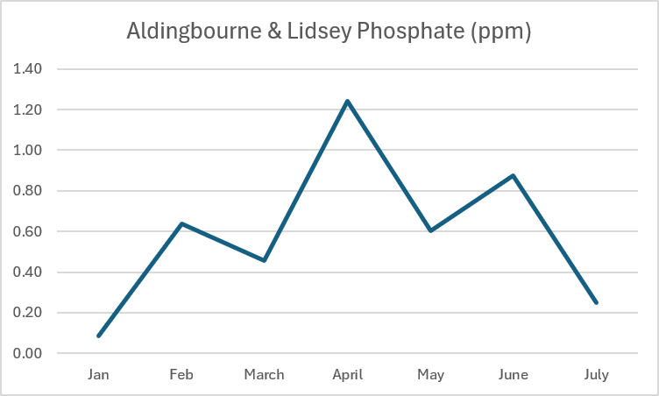
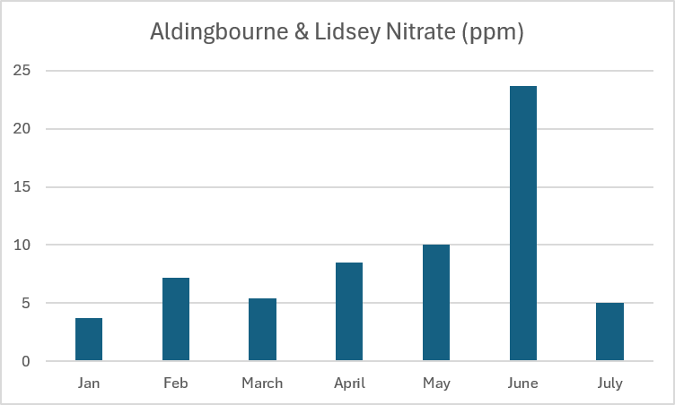
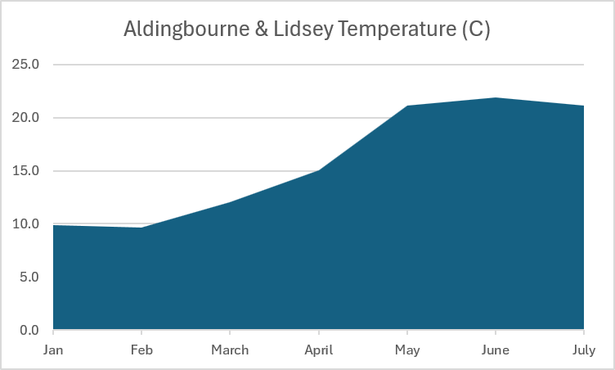
Aldingbourne & Lidsey – Result Averages
Jan 2026 to July 2026
Poor
Moderate

Slide 29
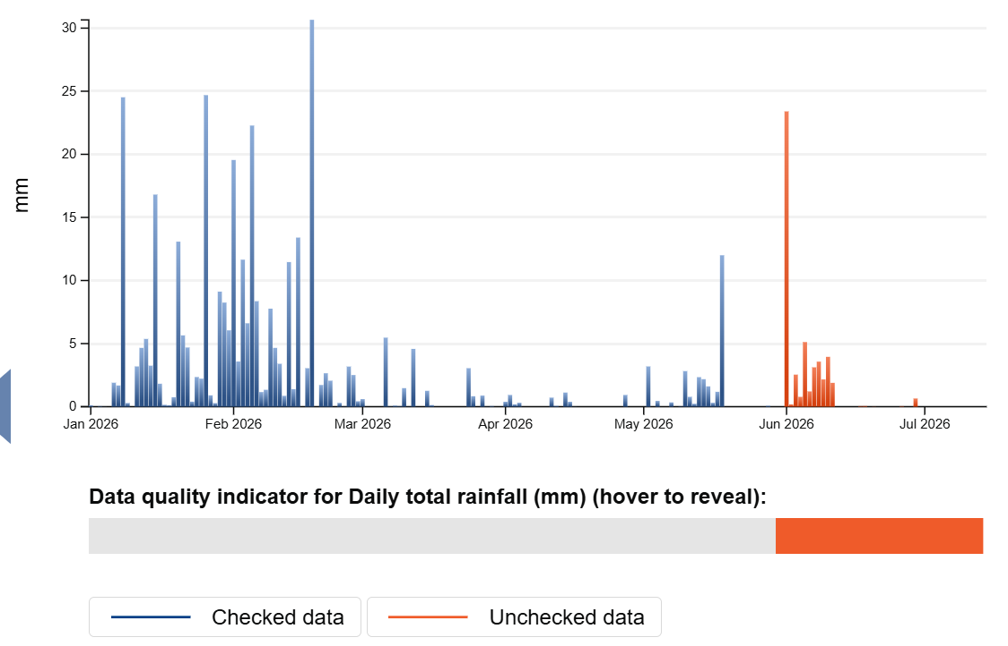
Rainfall Data at Fishbourne – last 6 months
Hydrology Data Explorer - Fishbourne

Slide 30
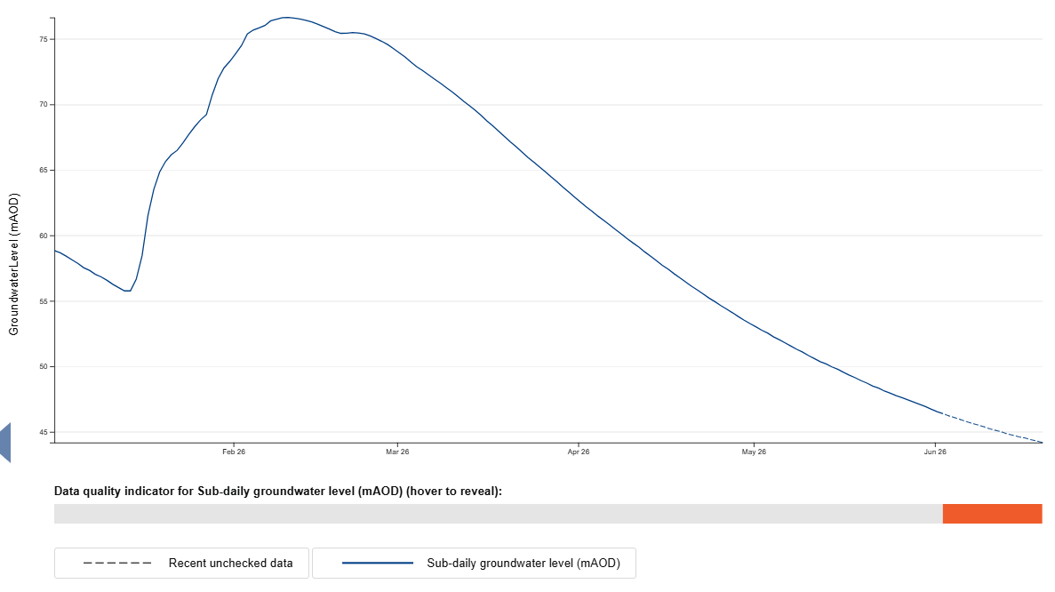
Groundwater Data at Chilgrove – last 6 months
Hydrology Data Explorer - Chilgrove House
Meters above ordnance datum

Slide 31
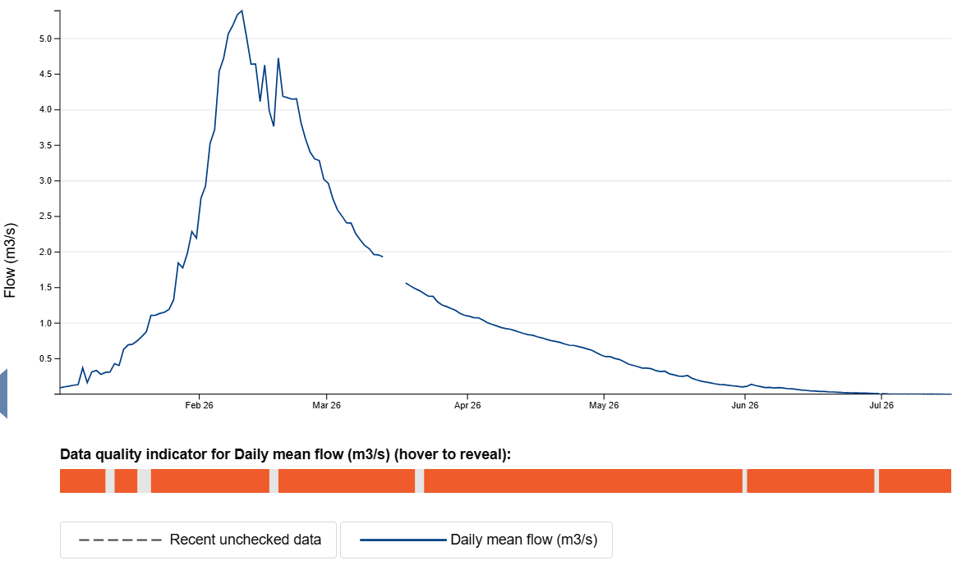
Flow Data at Graylingwell – last 6 months
Hydrology Data Explorer - Graylingwell

Slide 32
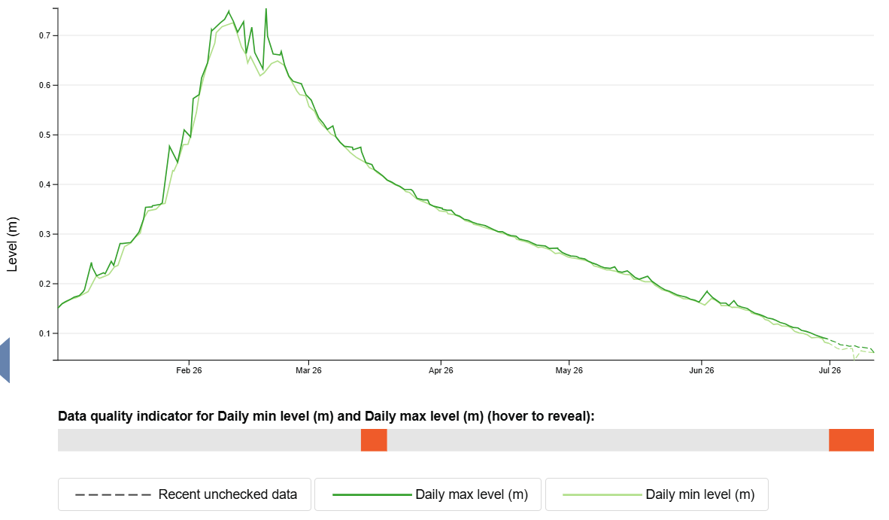
Water Level Data at Graylingwell – last 6 months
Hydrology Data Explorer - Graylingwell

Slide 33

Any Questions??

Slide 34
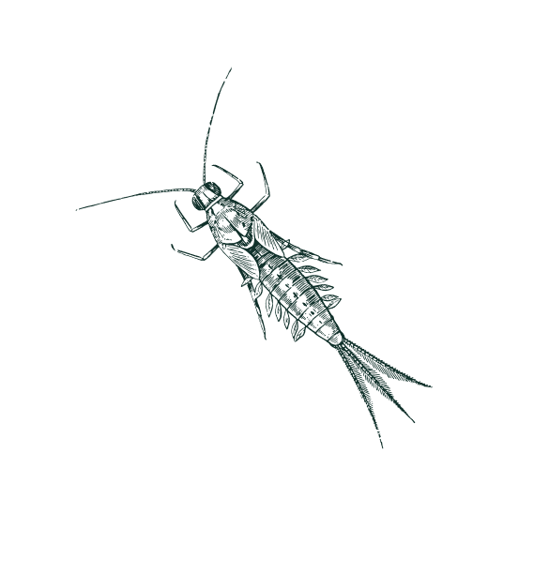
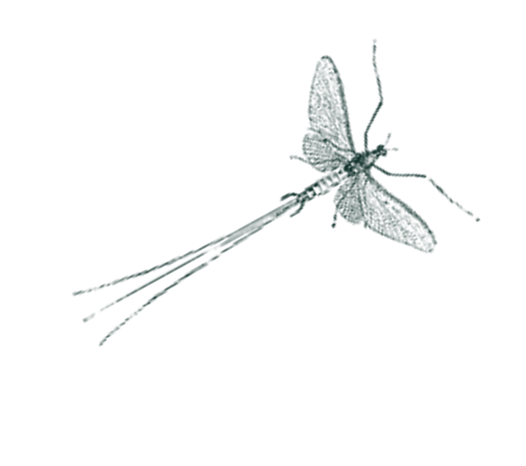
Riverfly review
1st January 2026 to 16th July 2026
12 sites have been monitored by
WSRT and Friends of the Ems groups
61 surveys completed
4 sites on the Ems
2 sites on the Ham Brook,
2 sites on the Bosham
4 sites on the Lavant

Slide 35
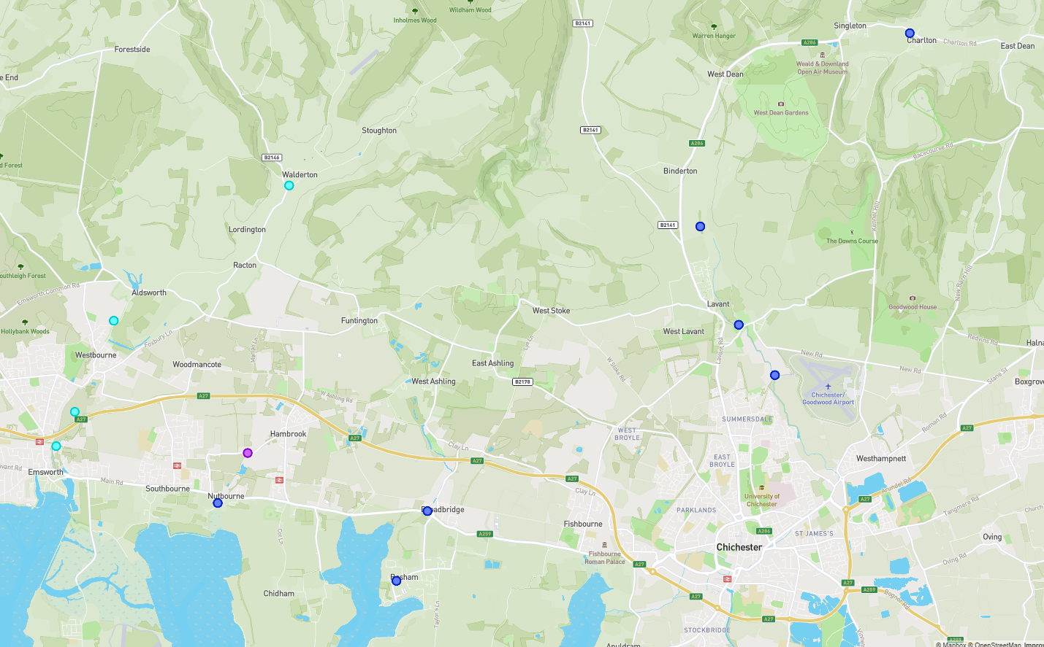
Riverfly Locations

Slide 36
Riverfly review - Ems
4 sites monitored:
Walderton Junction
Brooklyn Cottage
Mill Meadows Farm (Trigger of 7)
Brook Meadows (Trigger of 7)
Walderton reported Low/No flow in June
Brook Meadows flooded in Feb
Species Found:
Cased Caddis
Caselesss Caddis
Blue-Winged Olive
Olives (Baetidae)
Stoneflies
Freshwater Shrimp
No:
Mayfly (Ephemeridae)
Flat-Bodied Stone Clinger
Highest RMI score was 14 at
Brooklyn Cottage
Lowest score was 2 at Walderton Junction

Slide 37
Riverfly review - Hambrook
2 sites monitored:
Blackbarn (Trigger of 7)
School Lane (Trigger of 5)
Species Found:
Cased Caddis
Caselesss Caddis
Blue-Winged Olive
Olives (Baetidae)
Freshwater Shrimp
No:
Mayfly (Ephemeridae)
Flat-Bodied Stone Clinger
Highest RMI score was 12 at School Lane
Lowest RMI scores were 9 at both site

Slide 38
Riverfly review - Bosham
Species Found:
Cased Caddis
Caselesss Caddis
Blue-Winged Olive
Olives (Baetidae)
Stoneflies
Freshwater Shrimp
No:
Mayfly (Ephemeridae)
Flat-Bodied Stone Clinger
2 sites monitored:
Old Bridge Meadow (Trigger of 5)
The Millstream Hotel (Trigger of 5)
Highest RMI score was 12 at both sites
Lowest RMI scores was 5 at The Millsteam Hotel

Slide 39
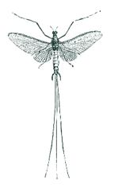
Riverfly review - Lavant
4 sites monitored:
Charlton
Marsh Lane
Sheepwash Lane (Trigger of 5)
Fordwater (Trigger of 5)
Species Found:
Cased Caddis
Caselesss Caddis
Blue-Winged Olive
Olives (Baetidae)
Stoneflies
Freshwater Shrimp
No:
Mayfly (Ephemeridae)
Flat-Bodied Stone Clinger

Slide 40
Riverfly review - Lavant
Highest RMI scores were 9 at Fordwater and Sheepwash
Lowest RMI scores was 0 at Marsh Lane and Sheepwash during first flow and first survey of the season in Jan
Fordwater breached the trigger level, this is expected but not ideal.
Sheepwash Lane has now dried out for the summer (Winterbourne)

Slide 41
Riverfly Results (Max)
Species | Count
Cased Caddis | Up to 1250
Caseless Caddis – | Up to 49
Mayfly (Ephemeridae) | None found in catchment
Blue-Winged Olive (Ephemerellidae) | Up to 1280
Flat-Bodied Stone Clinger (Heptageniidae) | None found in catchment
Olives (Baetidae) | Up to 450
Stoneflies (Plecoptera) | Up to 503
Freshwater Shrimp | Up to 1993

Slide 42
Any Questions??

Slide 43


Slide 44
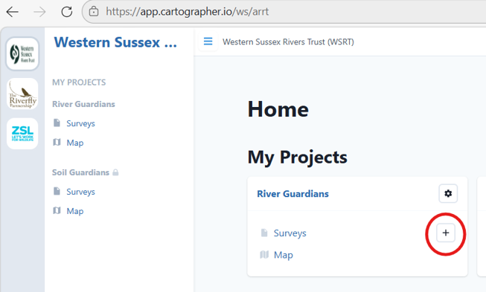

Slide 45

Duplicate

Slide 46


To move the pin
Open survey
Zoom in
Click on correct location

Slide 47
Any Questions??

Slide 48

Download Survey Data – 3 ways
1
For specific survey data, use the search box then click download

Slide 49



Open the map, zoom in so that the pins you are interested in are shown on the map page.
Scroll down to the bottom of the legend and click
‘Download Map Data’
2
For multiple sites located close together

Slide 50

3
For larger areas

Slide 51

Select the area you are interested in by clicking on the map

Slide 52


Slide 53
Any Questions??

Slide 54
Overview – Sewage Untreated
32 spilling assets in the Western Streams Catchment
Discharged untreated sewage 7870 times
for of over 16,367 hours
Spill data can be found and downloaded from:
Southern Water - Rivers and Seas Watch
Check EDM data and download via:
Event Duration Monitoring - Storm Overflow Explorer

Slide 55


Slide 56

Spill hours rounded down from Rivers & Seas website data on 21st July 2026

Slide 57

Sewage Discharges – RG Monitoring
15* sites are not currently being monitored regularly both up and downstream:
*This list has not been checked recently. If you are interested in taking on one of them then please chat with Sam.

Slide 58

Other Issues
Soil run-off
Livestock poaching riverbanks
Farms
Golf courses, run off from fertilizers & abstraction
What else are you finding?

Slide 59
Kit Maintenance
Cleaning and drying your kit at the end of your survey day is good practice.
Prolongs the life of your monitoring equipment
Prevents the spread of invasive species (INNS)
Prevents nutrient and chemical contamination between samples
Hanna Checker cuvettes, water collection device, syringe, Secchi tube
Rinse out with warm water and leave to air dry
TDS/Temp monitor pens
Soak the tips in lukewarm water for 5 mins then air dry before replacing cap

Slide 60

Health and Safety - reminders
Always go out in pairs
Let someone know where you are heading and what time you expect to be back
Always wear gloves – Protect from water and reagents
River Guardian Risk Assessment is being updated
Link: Home and Dry - Water Safety Course - West Mercia Search and Rescue
Link: Tick awareness A5 leaflet for printing

